Slide 1
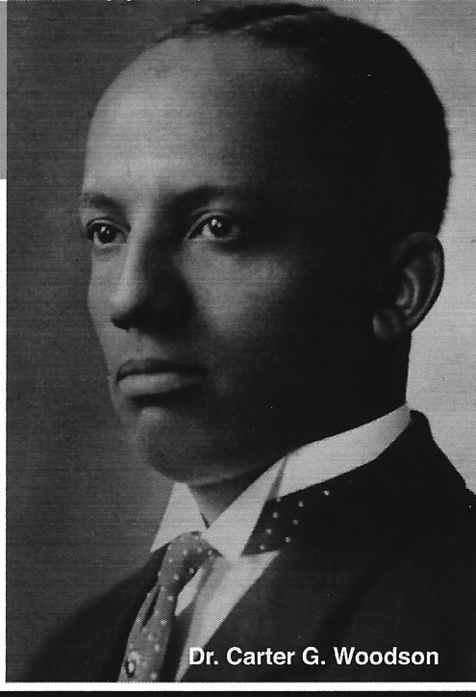
ASALH Association for the Study of African American Life and History
“The Founders of Black History Month”

Slide 2
Who in 1926, conceived Negro History Week, which is now celebrated as Black History Month?

Slide 3
Dr. Carter G. Woodson, the “father” of Black History, founded:
The Association for the Study of Negro Life and History (now ASALH) in 1915).
The Journal of Negro History (now the Journal of African American History (JAAH)), in 1916.
Associated Publishers, in 1921.
(Purchased) In 1922 the Ninth Street home that is now a national historic site in Washington, DC.
Negro History Week in 1926.
In 1937, Negro History Bulletin (now Black History Bulletin).
In 1976, ASALH expanded Negro History Week to Black History Month.

Slide 4
ASALH’s MISSION
To promote, research, preserve, interpret, and disseminate information about Black life, history, and culture to the global community.

Slide 5
Did You Know?
The Association for the Study of African American Life and History establishes the official Annual Black History Theme. Millions of people around the world observe and study this theme the entire year.

Slide 6
WHY FEBUARY?
LET’S SHATTER THE MYTH
Dr. Woodson chose the week between what Frederick Douglass believed to be his birthdate and the birthday of President Abraham Lincoln because of their significance to African American history. Records were sometimes not kept or were incorrectly recorded for enslaved people. Douglass thus chose February 14.
The purpose of this History week/month is to share and celebrate what we learned.

Slide 7
Dr. Carter G. Woodson in his library 1538 Ninth Street, NW, Washington, DC
Did you know that Dr. Carter G. Woodson lived in Northwest Washington, D.C.?

Slide 8
Q. When did Carter G. Woodson occupy the home and how long did he reside there?
Dr. Woodson lived there from 1922 until his death in 1950.

Slide 9
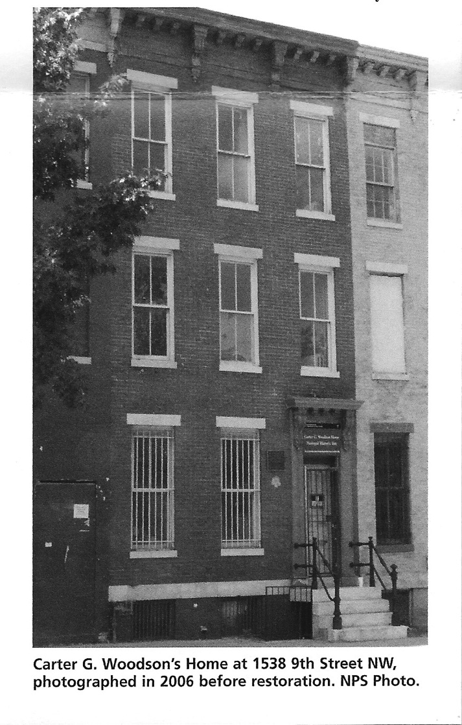
The National Park Service (NPS) Woodson House
Q. Can I tour the house?
A. Yes. The house is available for tours Friday – Sunday, 10 a.m. – 3:30 p.m. Call 202-690-2525 for reservations.

Slide 10
Q. When did NPS open the home?
The home opened for a Special Preview in February 2017. NPS oversees the restoration of the home at 1538 and additional buildings 1540 & 1542, that make up the Historic Site. Planning involved:
1. Historic Resource Study;
2. Historic Structures Report;
3. A General Management Plan.
NPS uses these planning documents to determine the methods of restoration, interpretive themes and visitor facilities. Members of the public also provided input in the designs.

Slide 11
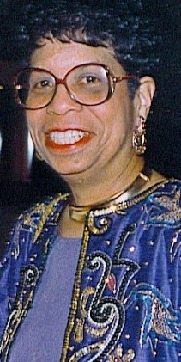
Woodson Home Committee Chair, Dr. Bettye J. Gardner This committee serves as a partner with NPS in the interpretation and programs for the historic site.
Barbara Spencer Dunn, Co-Chair
Dorothy F. Bailey
Thomas Battle
Elizabeth Clark-Lewis
Pero Dagbovie
John E. Fleming
Cheryl Gooch
Jim C. Harper
Cheryl Laroche
Renada Johnson
Lopez Matthews
June Patton
Tiffany Spriggs
Ex-Officio: Evelyn Brooks Higginbotham,
President
Sylvia Y. Cyrus, Executive Director

Slide 12
National Heritage Sites Research Committee Barbara Spencer Dunn and Bettye J. Gardner, Co-Chairs
This committee oversees the work of the Master Cooperative Agreement with NPS to include, but not limited to, selection of Principal Investigators and Peer Reviewers for all NPS and CESU Task Agreements.
Elizabeth Clark-Lewis
Vincent Deforest
John W. Franklin
Jarvis Ray Givens
Cheryl Renee Gooch
Dale Glenwood Green
Sharon Harley
Jim C. Harper
Robert L. Harris
Ida E. Jones
Lionel Kimble
Lopez Denoble Matthews
Edna Greene Medford
Janet Sims-Wood
Gabrielle Tayac
Francille Wilson

Slide 13
ASALH ACTIVITIES
ASALH’s Woodson Home Committee works with the National Park Service to interpret exhibits and the design of the Woodson Home Historic Site on 9th Street, NW in Washington, DC.

Slide 14
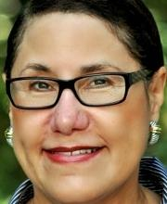
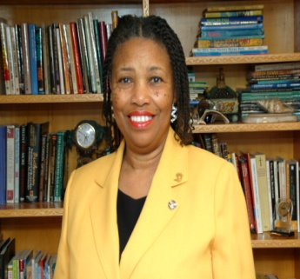
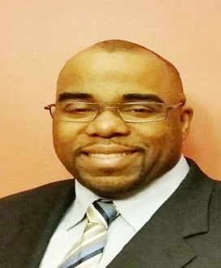
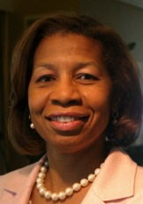
Who’s Who on the ASALH Team:
Dr. Evelyn Brooks Higginbotham ASALH National President
Mrs. Barbara Spencer Dunn
Vice President for Membership
Dr. Lionel Kimble
Vice President for Programs
Ms. Sylvia Y. Cyrus, Executive Director
Managing Director ASALH Publications

Slide 15
ASALH Headquarters Team
Sylvia Cyrus Executive Director
Crystal Boswell Operations Manager
Rachelle Eloizin Asst. to the Executive Director
Kay Phillips Project Manager, NPS & CESU Task Agreements
Tina McIntyre Finance Manager

Slide 16
ASALH ACTIVITIES
ASALH establishes the annual Black History theme, which is announced during the month of February each year.
The President of the United States issues a proclamation recognizing the Black History Theme ASALH establishes each year.
To view the 2019 Proclamation visit the ASALH website at www.asalh.org.

Slide 17
What about adjacent properties to the home? Has the NPS purchased those?
Yes, the NPS has purchased 1540 and 1542 9th Street, NW from Shiloh Baptist Church. These buildings make up the Historic Site and includes space for ASALH to return home, NPS Ranger Station and office space, a Visitor Center, Classrooms and other functions related to the Historic Site.
Q. Will the NPS and ASALH continue their partnership?
A. Absolutely. The NPS values the relationship it has enjoyed over the years with ASALH. The Association has a Master Cooperative Agreement with NPS and will maintain an administrative presence at the home and continue to work with the NPS to develop interpretive and educational programs for the site and throughout the nation.

Slide 18
ASALH ACTIVITIES
ASALH creates a variety of educational products each year related to the Annual Black History theme.
The 2015 Black History theme celebrated the 10th year of Freedom’s Song.
“A Century of Black Life, History and Culture”

Slide 19
ASALH ACTIVITIES Publishes “The Journal of African American History” The Jewel of ASALH Editor, Dr. Pero Dagbovie

Slide 20
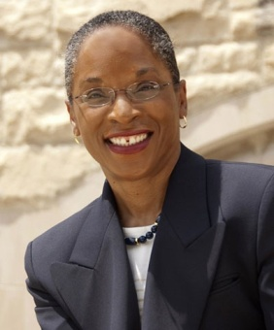
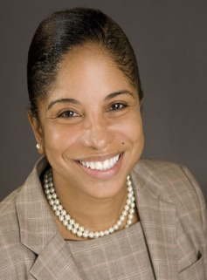
Black History Bulletin Team
Dr. LaVonne Neal
Co-Editor
Dr. Alicia Moore
Co-Editor
The Black History Bulletin (BHB) is dedicated to enhancing teaching and learning. Its aim is to generate, publish, and disseminate peer-reviewed information about African Americans in U.S, history, the African Diaspora generally, and the peoples of Africa.
It enhances the knowledge base for the professional praxis of secondary educators through articles that are grounded in theory, yet supported by practice. The BHB welcomes articles on all aspects of Black history, especially those written with a focus on: (1) middle school U.S. history; (2) high school U.S. history; (3) teacher preparation, U.S. history methods.

Slide 21
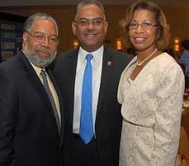
ASALH presents an annual Black History Luncheon each February as one of its fund-raising activities.

Slide 22
2013 Black History Luncheon Wardman Park Marriot Hotel
The National President of Omega Psi Phi Fraternity, Inc. Dr. Andrew Ray, ASALH Executive Director Sylvia Cyrus, and members of the fraternity. The Omegas presented ASALH with a $10,000 check to support the legacy and work of the founder of ASALH Dr. Carter G. Woodson, who was an Omega man.

Slide 23
Luncheon Leadership Team
Co-Chairs
Dr. Gladys Gary Vaughn
Dr. Sharita Jacobs Thompson
Leadership Team
Ms. Sylvia Cyrus
Mrs. Cheryl Gresham
Mr. Louis Hicks
Dr. Valerie Maholmes

Slide 24
ASALH PARTNERSHIPS
National Underground Railroad Conference Sept 11 – 14, 2019
Niagara Falls, NY
African American Civil War Memorial Freedom Foundation and Museum

Slide 25
ASALH PARTNERSHIPS
Kiamsha is a youth empowerment organization based in Prince George's County, Maryland, which facilitated 18 consecutive ASALH annual Youth Days (2000-2018) and promotes ASALH’S nationwide Family Research project. Kiamsha serves as the youth voice for the Woodson Home Committee.
ASALH and Farmers Insurance have collaborated on many projects, including the Freedom's Song educational DVD - a free documentary for middle and high school teachers to help students learn about significant, but often overlooked, events in Black history.

Slide 26
ASALH PARTNERSHIPS Maryland Commission on African American History and Culture
Teacher Training that inspires
MCAAHC 50th Anniversary

Slide 27
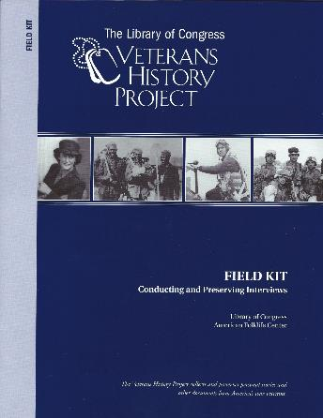
ASALH PARTNERSHIPS
ASALH has endorsed The Library of Congress’ Veterans History Project to assist in making sure African American voices will be amply represented in the history of American wars. For more information visit the Veterans History Project website: http://www.loc.gov/vets//vets-home.html

Slide 28
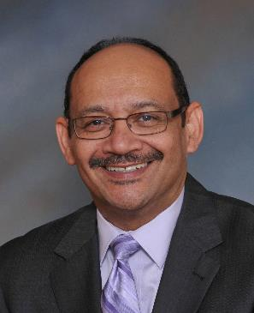
2015 ASALH Centennial Rays of Light Honorees Interviewees answered the Question: How has Dr. Woodson impacted your life and your life’s work? Complete interview will be featured at the Woodson Historic Site when site is completed.

Slide 29
ASALH VISION
The vision of the Association for the Study of African American Life and History is to be the premier Black Heritage learned society with a strong network of national and international branches and partners whose diverse and inclusive membership will continue the Woodson legacy.

Slide 30
Help ASALH Realize its Vision, become a Member.

Slide 31
Branches of ASALH https://asalh.org/members/branch-directory/
Our Authors Study Club (CA)
C. Delores Tucker (DC)
Carter G Woodson (DC)
Bethel Dukes (DC)
Dorothy Turner Johnson (FL)
Manasota (FL)
James Weldon Johnson (FL)
ASALH Tampa Bay (FL)
St. Petersburg (FL)
South Florida (FL)
Athens (GA)
Atlanta (GA)
Chicago (IL)
Joseph T. Taylor (IN)
Carter G. Woodson Louisville (KY)
Martha’s Vineyard (MA)
Van McCoy Legacy (MD)
Roland McConnell (MD)
Julian (MD)

Slide 32
Branches of ASALH continued https://asalh.org/members/branch-directory/
Prince George’s County Truth (MD)
Samuel L. Banks (MD)
Detroit (MI)
Greater Kansas City (MO)
Bronx (NY)
Manhattan (NY)
Sullivan County (NY)
Paul Laurence Dunbar (OH)
Margaret and Robert Garner (OH)
Cleveland (OH)
Edna McKenzie (PA)
Philadelphia Heritage (PA)
Phila-Montco (PA)
Charleston (SC)
W. Marvin Dulaney (TX)
Memphis (TN)
Hampton Roads (VA)
Louisa (VA)

Slide 33
Membership Benefits Include:
Digital access to all copies of the Journal of African American History (JAAH) since its founding on 1916; Only Branch members receive hard copies of JAAH. (Formerly the Journal of Negro History, the Jewel of ASALH, edited by Dr. Pero Dagbovie)
Digital copies of BHB and Fire!!!
Discounts on Conference Registration Fees
Corporate and Institutional Members also receive the Black History Month "Kit" (Posters, Learning Resources (content varies each year)), two subscriptions to the JAAH and Black History Bulletin, (Co-Editors Drs. LaVonne Neal and Alicia Moore); discount for two persons on Conference Registration Fees; Two votes at Executive Council elections, and all the same benefits that individual members receive

Slide 34
Membership Benefits, continued
One vote at each year’s Executive Council election
Ability to post books to the ASALH Bookshelf
Free postings of your news, events, and jobs to the ASALH Community Board
Ability to present at the annual ASALH conference
Ability to participate in the conference author’s book signing

Slide 35
For more information contact:
Association for the Study of African American Life and History
(ASALH)
301 Rhode Island Avenue, NW, Suite 2204
Washington, D.C. 20001
Office: 202.238.5910
Website: www.asalh.org

