Slide 1
Association for the Study of African American Life and History
Treasure’s Roles and Responsibilities
Prepared by Valerie Holt, Treasurer

Slide 2
Financial Management
Branch Treasurers are Very Essential Persons
A strong financial management foundation and record-keeping system is key to branch stability and success.

Slide 3
Topics for Today
Treasurer’s Roles and Responsibilities
Best Practices for Cash Handling, Invoice Payments
Internal Controls: Procedures to safeguard assets and check the accuracy and reliability of accounting data
Budget and Operations Planning
501(c)(3) Status
Annual Financial Report
Tips for New Treasurers

Slide 4
Treasurer’s Roles and Responsibilities
Treasurers serve in many roles:
Chief Accountant,
Budget Officer,
Business Advisor,
Fund Raiser,

Slide 5
Treasurer’s Roles and Responsibilities
Ensure that the branch has applied for its own state employer identification number (EIN) within 10 days of chartering.
Open a Branch Bank Account, a requirement to be a branch in good standing. The checking account, preferably interest bearing, must be established in the name of the branch within 15 days of receiving an EIN. The branch must use its own EIN number (not an individual’s SSN) to establish an account. The branch president and treasurer must be listed as the authorized signers. Both signatures are required for payments of $2,500.00 or more.
Prepare and submit an Annual Financial Report to ASALH National by January 31-use template provided by National
Never place the branch’s money in any officer’s personal checking account.

Slide 6
Treasurer’s Roles and Responsibilities
Serve as a member of the Standing Budget and Finance Committee but not its chair.
Give a Treasurer’s report at each branch meeting.
Must be responsible for all financial transactions and custody of financial documents.
Deposit monies received in a branch bank account approved by ASALH and pay all bills signed by the President.
Keep an accurate record of all monies deposited and spent.
Establish a records management system for all financial records.

Slide 7
Best Practices for Excellence in Financial Management
Keep an accurate record of all monies deposited and spent.…Maintain two cash journals:
Cash Receipts Journal to summarize all cash receipts.
Cash Disbursements Journal to summarize all cash disbursements.
If possible acquire an automated journal entry process software such as Quick Books

Slide 8
Best Practices: Cash Handling
Deposit checks/cash as soon as possible after receipt. (use a two part receipt book when receiving cash)
Make a copy of the check and attach the stamped deposit slip to the check copy. Note the purpose of the cash or check.
Update the cash receipts journal.
Maintain supporting documentation for audit and legal purposes.

Slide 9
Best Practices Invoice Payments
Obtain President’s written approval before the check is signed and issued.
Issue checks in the name of a specific payee- never issue with blank spaces.
Attach a copy of the supporting documentation, such as, invoices or letters to a copy of the check.
Update Cash Disbursements Journal.
Mark or stamp all invoices “PAID” to avoid duplicate payments.
Use checks or a debit or credit card attached to the bank account not cash to provide an audit trail and avoid misappropriation (have a per transaction spending limit on the debit card).

Slide 10
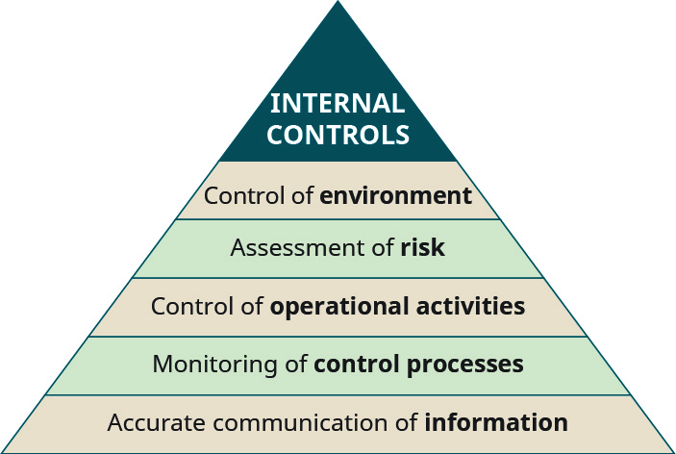
Internal Controls: Procedures To Safeguard Assets And Check The Accuracy And Reliability of Accounting Data
Strong internal controls can help minimize the possibility of misappropriation of assets or misstatement of accounts while increasing the likelihood of early detection. Basic internal cash management and accounting controls include:
Restrictively endorse checks. Spell out the full name of the branch (no acronyms)
Write the branch’s bank account number on the check .
Write “For Deposit Only” when endorsing checks.
Severely restrict the use of cash.

Slide 11
Internal Controls: Procedures To Safeguard Assets And Check The Accuracy And Reliability of Accounting Data
Review the cash receipts and cash disbursements journal each month and ensure that amounts can be reconciled to bank account.
Have the Chair of the Budget and Finance Committee review the monthly cash disbursements journal to ensure that the transactions were properly authorized.
Comply with the requirement to have the President and Treasurer jointly sign all checks over $2,500.
Have a specified level at which the Board must approve the issuance of a contract.

Slide 12
Budget and Operations Planning
Actively participate in the annual budget development process through developing or vetting estimates for revenue and expenses.*
Issue written analysis as necessary to ensure budget development process results in a budget that is realistic and achievable.
Routinely review and compare actuals to estimates:
(example: forecast for new members and related dues should be routinely compared with actual new members per month).
Work with branch members to develop solutions when under performance is noted.
Prepare and deliver financial report at each branch meeting.
* Include payment to ASALH National Office in budget

Slide 13
Safeguarding ASALH’s 501 (c) (3) Tax Exemption
ASALH is a 501(c) (3) nonprofit professional organization that receives a federal tax exemption. As such, ASALH must obey certain rules established by the IRS to retain its tax-exempt status. All branches must comply with these rules as well.
ASALH must file a Form 990 tax return each year.
Information for the Form 990 tax filing comes partly from the annual reports submitted by branches. Branch submission of accurate and timely annual reports are essential to safeguard ASALH’s tax exempt status and to avoid tax penalties.
A branch may request to use ASALH’s Tax ID, provided the annual reporting requirement is met and that the branch is able to obtain the written approval of ASALH National.

Slide 14
Safeguarding ASALH’s 501 (c) (3) Tax Exemption
Branches need to be aware of activities that 501(c) (3) organizations cannot engage in:
Political campaign activity to financially support, endorse, or oppose any political candidates verbally or in writing.
Lobbying activities to urge members to support or oppose legislation.
Enable personal benefit from the branch’s income or assets to insiders, such as, branch officers and members.
Allowing individuals or other organizations to obtain private benefits from donations for uses that are not aligned with the purpose of ASALH’s mission.
Generating Unrelated Business Income, in other words, too much income from a purpose that is unrelated to that of ASALH.

Slide 15
Should My Branch Apply for 501(c)(3)
Becoming a 501(c)(3) requires an application, accurate record keeping, and completing an annual tax filing.
Branches interested in recurring grant funding or large-scale fundraising activities should apply for a separate tax-exemption.
Applicants should consider obtaining professional assistance to ensure that the application is complete and accurate; that the financial record keeping system supports accurate and timely reporting; and that compliance requirements such as the annual report to ASALH National are routinely followed.
Consider have an audit performed prior to applying (not required)
Many companies provide low cost support for processing applications.

Slide 16
Preparing the Annual Financial Report
Two report formats
A report format for Branches with 501(c)(3) status
A report format for Branches without a separate 501(c)(3)
Reports are due on January 31st of each year.
The report formats are being updated and enhancements are being made to the supporting technology.
Training on the update forms will be provided in November 2022.

Slide 17
Three Tips for New Treasurers
Tip #1: Ensure You Have All the Necessary Accesses
Obtain all bank account records and details. Get the bank forms required to update signature cards and online account access as soon as possible.
Transfer credit card authorizations.
Have all checkbooks and credit cards turned over to you that were in the possession of the former treasurer.
Tip #2: Receive Onboarding From the Previous Treasurer
Onboarding is just the process of a previous person who held a position helping you "onboard" by offering advice and assistance with your job duties and helping you understand existing policies since they already have the experience.
Tip #3: Create a Calendar of Upcoming Financial Deadlines

