Slide 1
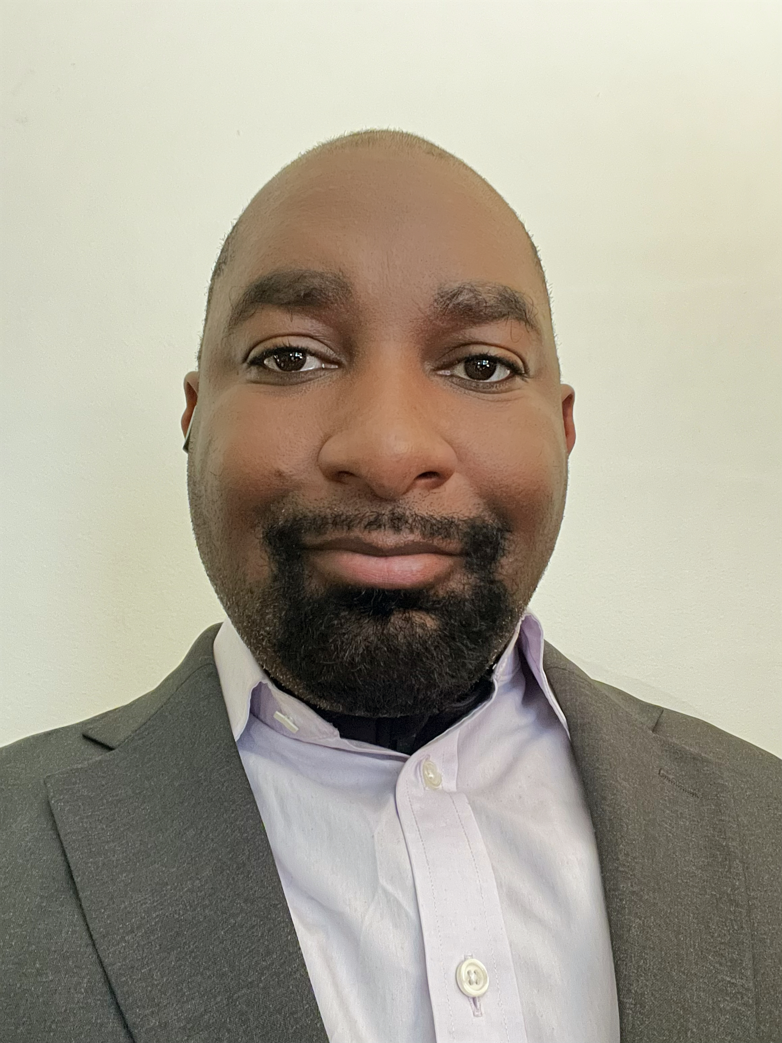
Albert Thompson Jr.
DISSERTATION: RACE AND THE LIBERAL STATE, 1932-1968 MINOR FIELDS: PUBLIC HISTORY, AFRICAN DIASPORA
FELLOW, Royal Society for the encouragement of Arts, Manufactures and Commerce, London, United Kingdom
MEMBER, The Zeta Gamma Chapter of the history honor society Phi Alpha Theta
NIH HEAL CONNECTIONS- CULTURAL RESPONSIVENESS WORKGROUP (CRW)
RESEARCH ASSISTANT & SUPERVISING ARCHIVAL GRADUATE
FOR THE COL. CHARLES YOUNG 1903 NATIONAL PARK SERVICE PROJECT

Slide 2
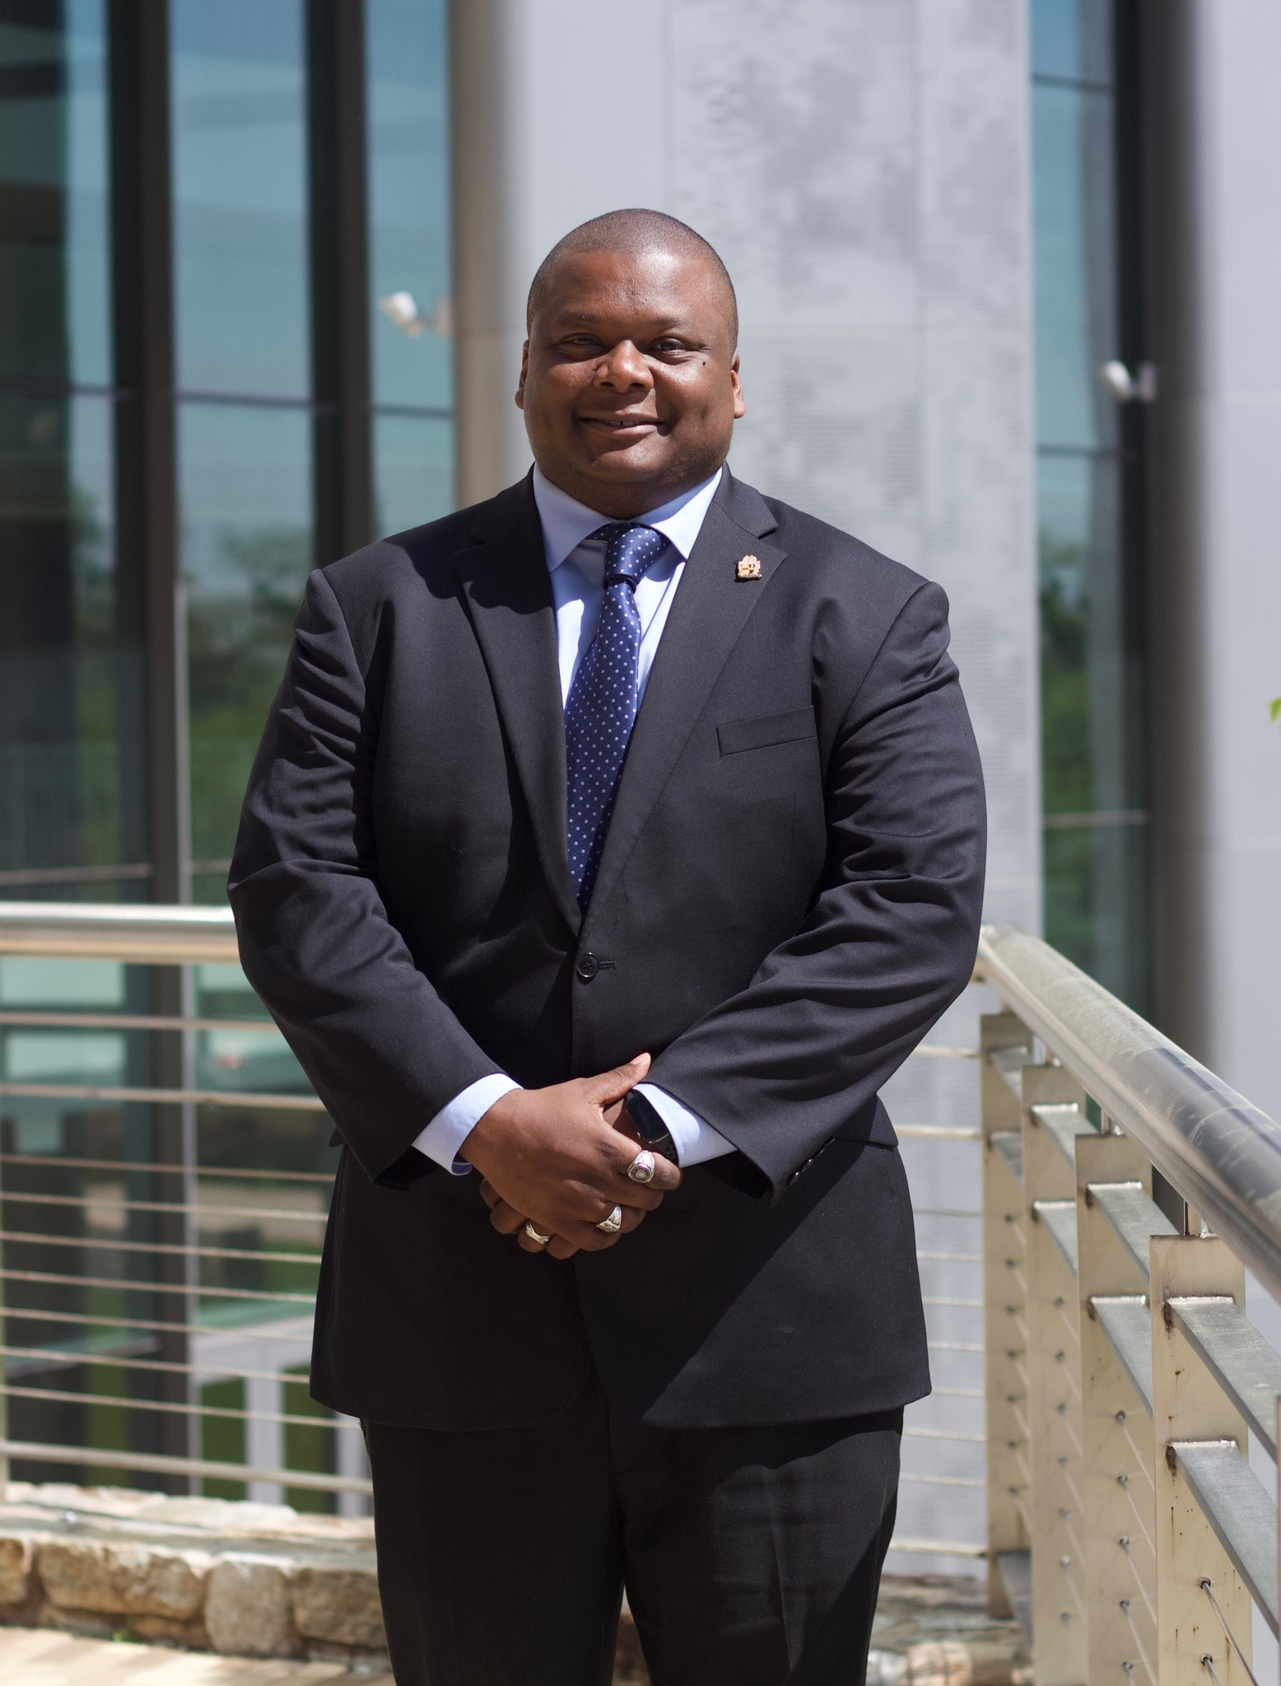
James Morgan
International African American Museum: Senior Genealogy Consultant
Bishop Henry McNeal Turner Project: Advisory Board Member
The Phylaxis Society, Honorary Fellow & Life Member
“To implement an effective recruiting strategy, bring greater awareness of our mission to the public, and increase our membership beyond its historic past.”

Slide 3

Tomiko M. Meeks
Thesis topic: Economic Development: Sonangol, The Role of the National Oil Company in Economic Development 1970 to present
Board of Directors, Texas Oral History Association (TOHA)
Member, Texas Distance Learning Association (TxDLA)
Board of Directors, Central Texas Historical Association (CTHA)
Professional Human Resources Professional Certificate Rice University, The Institute for Human Resource Education
B.S. – Industrial/Organizational Psychology
Certified Paralegal

Slide 4
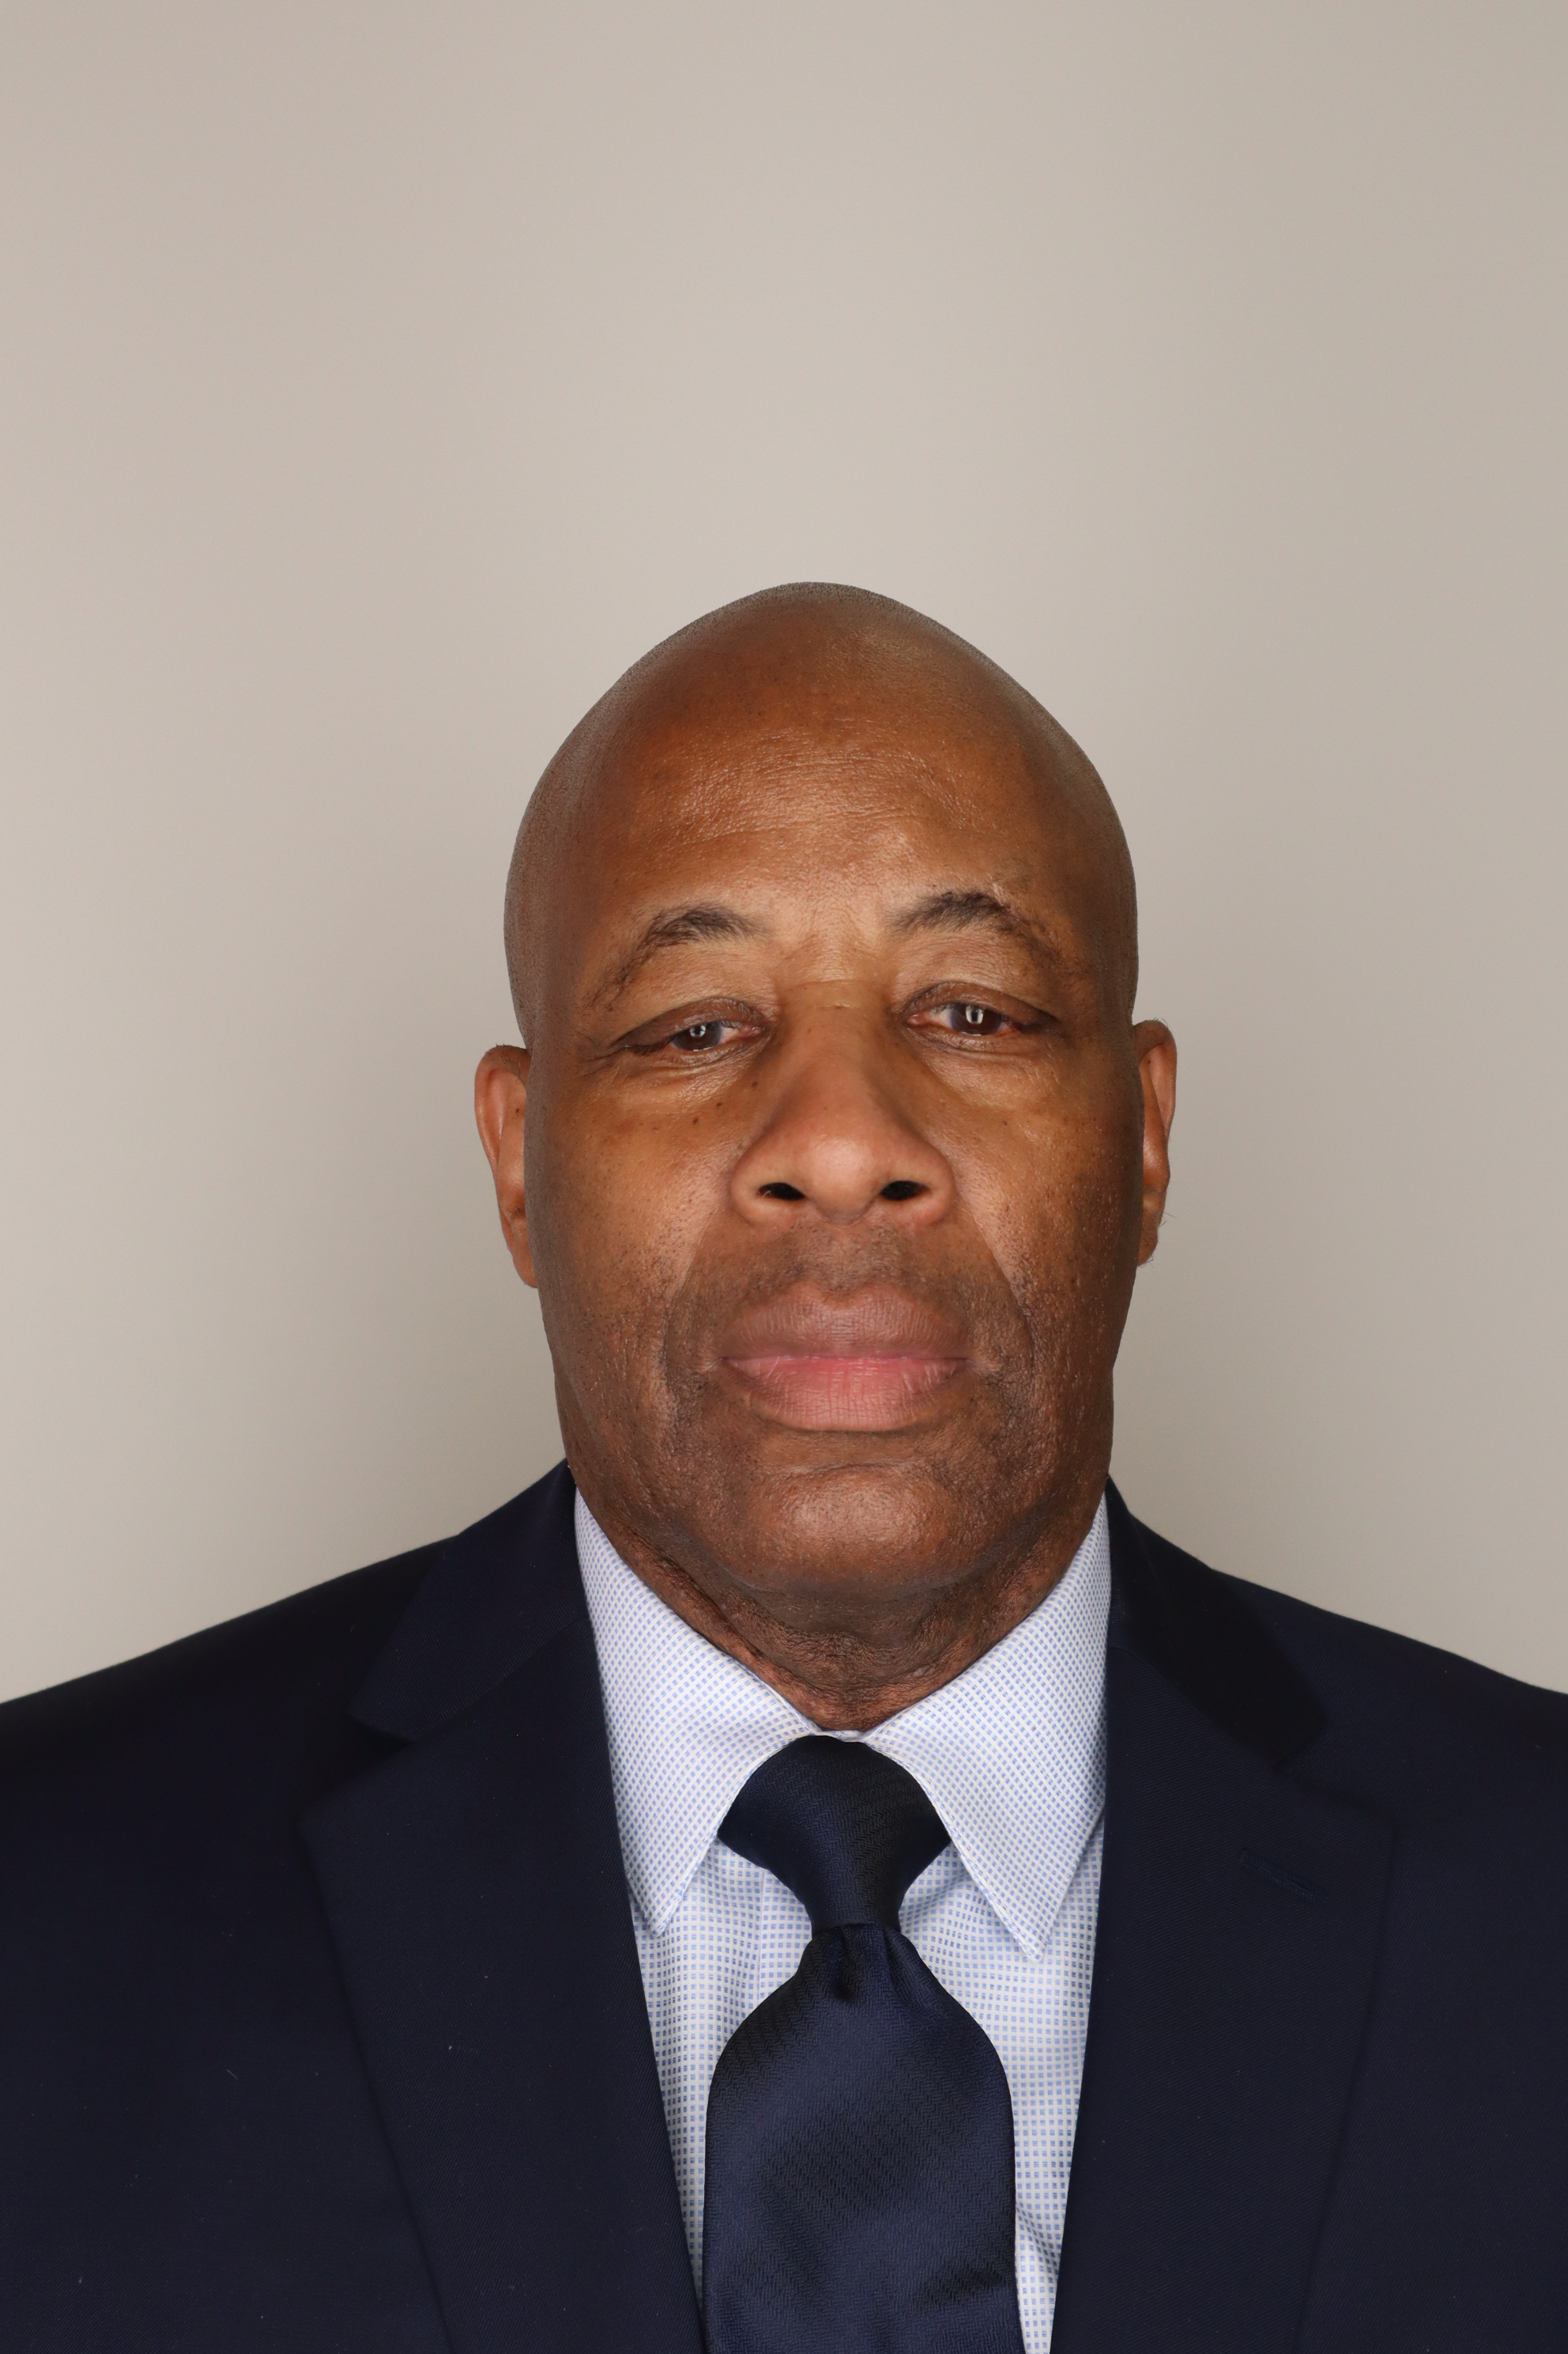
William Johnson
Human Resources Technician: United States Marine Corps
Human Resources Administrator: NROTC, Maritime College
Program Specialist and Health Benefits Advisor: Planned and managed a $210.000 training and recreation budget for the fiscal year.
Black Belt Certificate: Awarded by President Un Yong Kim of the World Tae Kwon Do Kukkiwon Seoul, Korea.
“To implement an effective recruiting strategy, bring greater awareness of our mission to the public, and increase our membership beyond its historic past.”

