Slide 1
Presentation to Governance December 31, 2023 Audit Results
Association for the Study of African American Life and History

Slide 2
Introductions
SB & Company, LLC Leadership Team
Pamela Gray, Engagement Partner
Kenzy Cisse, Audit Manager
2
Notes:
Engagement team

Slide 3
Executive Summary
Scope of Services
Audit of December 31, 2023 financial statements
Preparation of the Federal Form 990
Recommendations and observations noted during the audit process
Available for year-round consultation
Results
Plan to issue an unmodified opinion on financial statements
No material weaknesses in internal controls were identified during the audit
No instances of fraud discovered or made aware of
Received full cooperation from management

Slide 4
Executive Summary (continued)
Areas of Audit Emphasis
Reconciliations of cash
Accuracy and collectability of receivables
Accuracy and completeness of liabilities- Legal confirmations
Recognition of revenue/net asset classification
Federal grant compliance
Financial viability

Slide 5
Audit Results
Association for the Study of African American Life and History

Slide 6
Assessment of Control Environment
Control Environment
Risk Assessment
Control Activities
Information and Communication
Monitoring

Slide 7
Evaluation of Key Processes
Treasury | Financial Reporting | Expenditures | Revenue
Cash Management Reconciliations | Accounting Principles And Disclosure Closing the Books Report Preparation General Ledger and Journal Entry Processing Verification and Review of Results | Accounts Payable Cash Disbursements Cutoff | Billing Cash Receipts Revenue Recognition Cutoff
Effective | Effective | Effective | Effective
Notes:
Engagement team

Slide 8
Status of Prior Year Recommendations
Observation | Recommendation | Status
Revenue | During our audit testing, we noted that deferred revenue was overstated. SBC recommends that ASALH review the agreement and ensure the proper treatment of revenue recognition. No issues noted in the current year testing. | Implemented
During the audit procedures, SBC noted that some organizational documents of ASALH have not been updated in many years. For example: Organizational chart Whistleblower policy Constitution and bylaws | SBC recommends that management and those charged with governance revisit these documents, document any changes, and have the approval of the updated documents memorialized via the minutes. Updated documents should include language as it relates to managing liquidity and the functional expense allocation methodology, as disclosed in the notes to the financial statements. Implementation of this recommendation will allow ASALH to have policies and procedures that are consistent with the current operations and provide a platform to monitor that the policies and procedures are being applied consistently. | In Progress

Slide 9
Financial Statement Highlights
Statements of Financial Position
As of December 31, 2023, 2022, and 2021

Slide 10
Financial Statement Highlights (continued)
Statement of Activities and Change in Net Assets
For the Years Ended December 31, 2023, 2022, and 2021

Slide 11
Required Communications
No Issues Noted
No
Issues
Noted

Slide 12
Required Communications
Auditor’s Responsibilities Under Generally Accepted Auditing Standards (GAAS)
The financial statements are the responsibility of management. Our audit was designed in accordance with auditing standards generally accepted in the United States of America, and provide for reasonable, rather than absolute, assurance that the financial statements are free of material misstatement.
Significant Accounting Policies
Management has the responsibility for selection and use of appropriate accounting policies. In accordance with the terms of our engagement letter, we will advise management about the appropriateness of accounting policies and their application.
The significant accounting policies used by management are described in the notes to the financial statements.
Auditor’s Judgments About the Quality of Accounting Principles
We discuss our judgments about the quality, not just the acceptability, of accounting principles selected by management, the consistency of their application, and the clarity and completeness of the financial statements, which include related disclosures.
We have reviewed the significant accounting policies adopted by Association for the Study of African American Life and History (ASALH) and have determined that these policies are acceptable accounting policies.
No Issues Noted
No
Issues
Noted
12

Slide 13
Required Communications (continued)
Audit Adjustments
We are required to inform ASALH’s oversight body about adjustments arising from the audit (whether recorded or not) that could, in our judgment, either individually or in the aggregate, have a significant effect on ASALH’s financial reporting process.
We are also required to inform ASALH’s oversight body about unadjusted audit differences that were determined by management to be individually and in the aggregate, immaterial.
There were no passed adjustments identified during the audit process.
Fraud and Illegal Acts
We are required to report to the ASALH’s oversight body any fraud or illegal acts involving senior management and fraud or illegal acts (whether caused by senior management or other employees) that cause a material misstatement of the financial statements.
During our discussions with management, we were not aware of suspected or alleged fraud that occurred.
No Issues Noted
No
Issues
Noted
13

Slide 14
Required Communications (continued)
Material Weaknesses in Internal Control
We are required to communicate all significant deficiencies in ASALH’s systems of internal controls, whether or not they are material weaknesses.
There were no material weaknesses noted during the audit.
Other Information in Documents Containing Audited Financial Statements
None.
Disagreements with Management on Financial Accounting and Reporting Matters
None.
Serious Difficulties Encountered in Performing the Audit
None.
Major Issues Discussed with Management Prior to Acceptance
None.
No Issues Noted
No
Issues
Noted
14
Notes:
Engagement team

Slide 15
Required Communications (continued)
Consultation with Other Accountants
To our knowledge, there were no consultations with other accountants since our appointment as ASALH’s independent public accountants.
Independence
As part of our client acceptance process, we go through a process to ensure we are independent of ASALH. We are independent of ASALH.
Non-Attest Services
We perform non-attest services for ASALH. They include filing of the Form 990, financial statement compilation assistance.
Management has designated an individual who possesses suitable skill, knowledge, and/or experience to oversee this service, and have taken responsibility for the service performed. We are independent of ASALH.
No Issues Noted
No
Issues
Noted
15

Slide 16
Required Communications (continued)
Subsequent Events
We were not made aware of any material subsequent events that have occurred that would affect the information presented in the accompanying financial statements or require additional disclosure.
Our Responsibility Related to Fraud
Plan and perform the audit to obtain reasonable assurance that there is no material misstatement caused by error or fraud;
Comply with GAAS AU-C 240, “Consideration of Fraud in a Financial Statement Audit”;
Approach all audits with an understanding that fraud could occur in any entity, at any time, by anyone; and
Perform mandatory procedures required by GAAS and our firm policies.
Examples of Procedures Performed
Discuss thoughts and ideas in areas where the financial statements might be susceptible to material misstatement due to fraud;
Understand pressures on the financial statement results;
Understand the tone and culture of the organization;
Look for unusual or unexpected transactions, relationships, or procedures;
Discussions with individuals outside of finance;
Evaluate key processes and controls; and
Consider information gathered throughout the audit.
No Issues Noted
No
Issues
Noted
16

Slide 17
Responsibility for Mitigating Fraud
External Auditor:
Evaluate management programs and controls to deter and detect fraud for identified risks
Reasonable assurance that financial statements are free of material misstatement due to fraudulent financial reporting or misappropriation of assets
Compliance with fraud standard (SAS 99)
Conversations with finance and operations personnel
Disaggregated analytics
Surprise audit procedures
Journal entry testing
Management:
CFO/Controller: controls to deter and detect fraud
General Counsel/Compliance: monitoring
AUDIT COMMITTEE
Financial Reporting Risk
Operational Risk
Compliance Risk
Financial Misconduct by Member(s) of Sr. Management of the Board
SENIOR MANAGEMENT
Fraudulent Financial Reporting
Costs & Expenses Avoided by Fraud
Misappropriation of Assets
Audit Committee:
Evaluate management identification of fraud risk
Evaluate implementation of fraud controls
Reinforce “tone at the top”
Conduct special investigations
Revenue & Assets Obtained by Fraud
Expenditures & Liabilities for an Improper Purpose
17

Slide 18
SBC’s Service Pledge to You
We will consistently deliver a Quality Product and Quality Service so that we have the opportunity to establish a Quality Relationship with you, allowing us to provide you with Quality Knowledge for your continual success. Only after we have provided you with the knowledge that enables your business to grow and prosper, we have hit the bullseye!
Our commitment to you is the execution of our Bullseye Philosophy. We execute this philosophy for every client, on every engagement, every time.
18

Slide 19
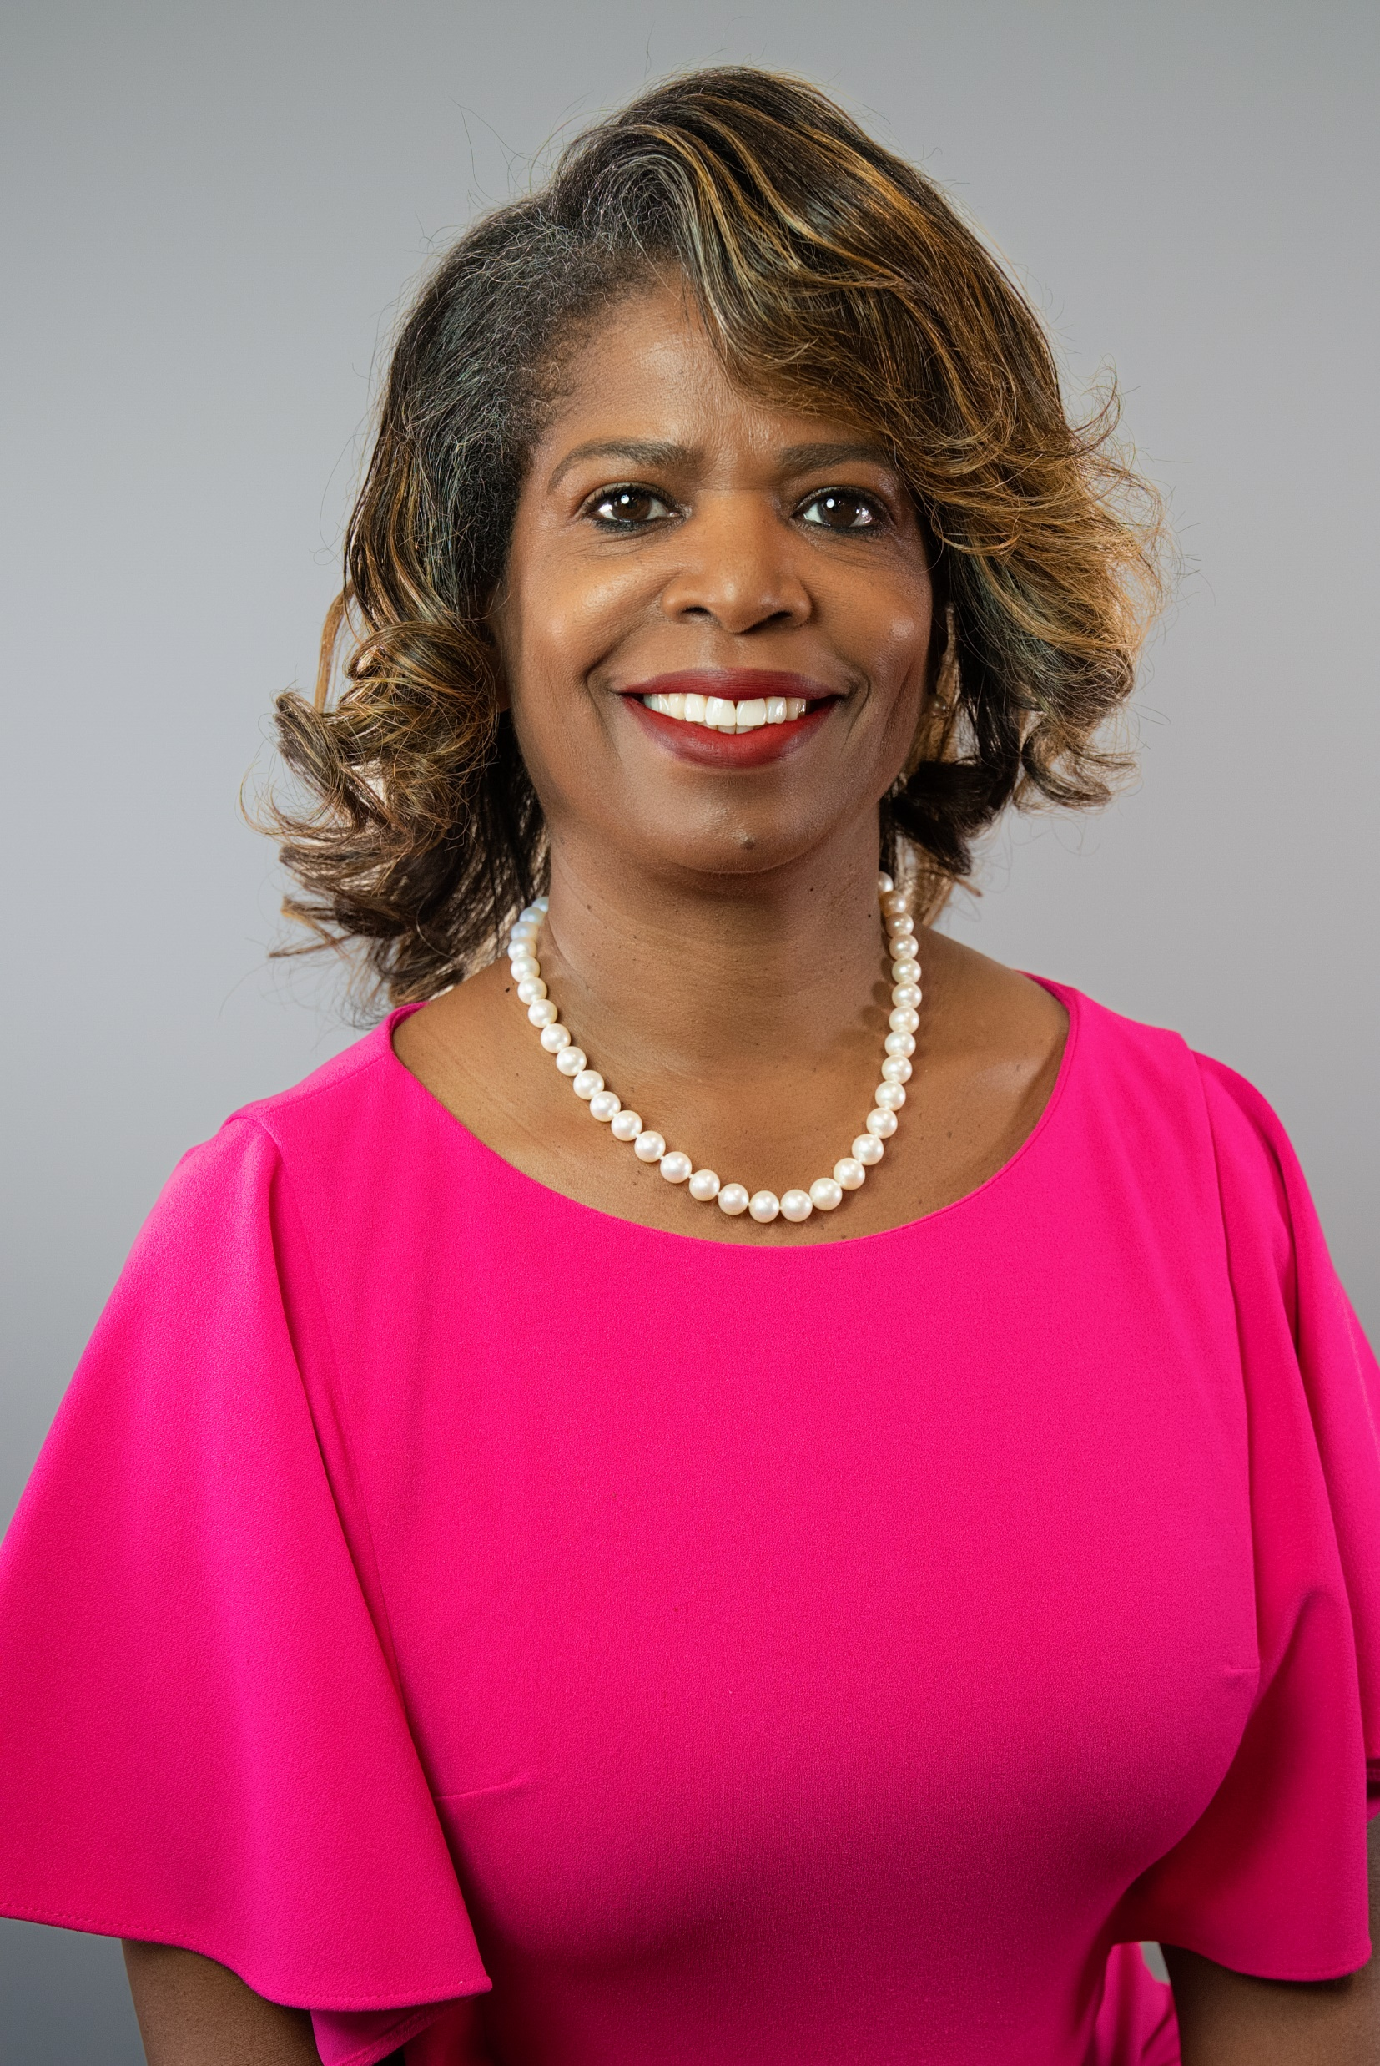
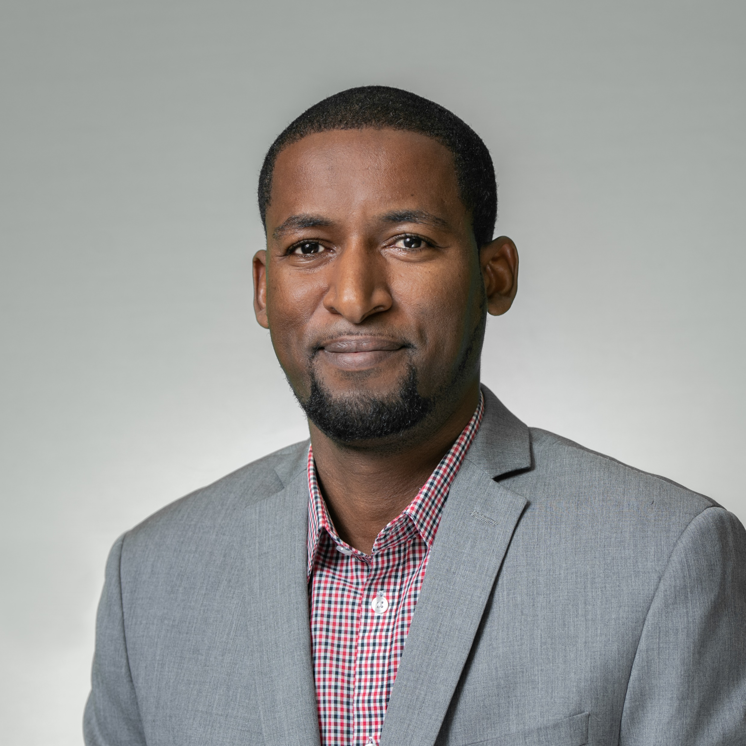
Contact Info
Engagement Team
Pamela Gray, CPA, MBA
Engagement Partner
Office: 410-584-1406
Mobile: 410-905-1372
pgray@sbandcompany.com
Executive Assistant
Susan Teneza
410-584-9303
steneza@sbandcompany.com
Kenzy Cisse
Audit Manager
Office: 410-584-2204
Mobile: 443-683-5761
kcisse@sbandcompany.com
19

Slide 20
Maryland
10200 Grand Central Avenue
Suite 250
Owings Mills, MD 21117
410.584.0060
Washington, D.C.
1200 G Street, NW
Suite 809
Washington, DC 20005
202.434.8684
Pennsylvania
1650 Market Street
Suite 3600
Philadelphia, PA 19103
215.665.5749
Virginia
6802 Paragon Place
Suite 410
Richmond, VA 23230
804.441.6290
South Florida
4000 Hollywood Boulevard
Suite 555-S
Hollywood, FL 33021
954.843.3477

