Slide 1

WELCOME TO THE
VIRTUAL ANNUAL BUSINESS MEETING
MONDAY, SEPTEMBER 23, 2024 | 7:30 - 9:30 P.M. EST
DR. W. MARVIN DULANEY, Presiding
Notes:
The correct end time for the meeting is 8:30 p.m. EST not 8:00 p.m.

Slide 2
VIRTUAL ANNUAL BUSINESS MEETING
STARTING SOON!
Notes:
The correct end time for the meeting is 8:30 p.m. EST not 8:00 p.m.

Slide 3
CALL TO ORDER
ASALH 2024 ANNUAL BUSINESS MEETING

Slide 4
MEETING LOGISTICS
KAYE WHITEHEAD, SECRETARY OF ASALH

Slide 5
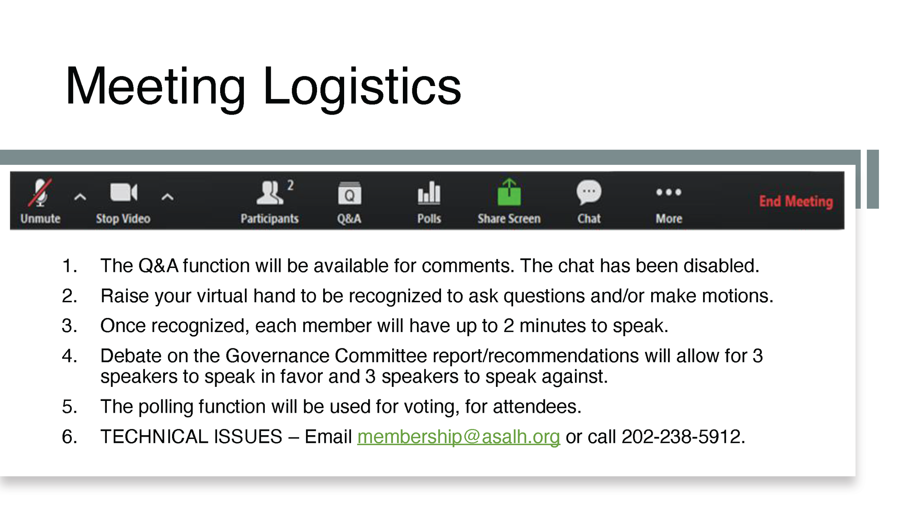
MEETING LOGISTICS
  The Q&A function will be available for comments. The chat has been disabled.
  Raise your virtual hand to be recognized to ask questions and/or make motions.
  Once recognized, each member will have up to 2 minutes to speak.
  Debate on the Governance Committee report/recommendations will allow for 3 speakers to speak in favor and 3 speakers to speak against.
  The polling function will be used for voting, for attendees.
  TECHNICAL ISSUES – Email membership@asalh.org or call 202-238-5912.

Slide 6
EXECUTIVE COUNCIL
Roll Call
KAYE WHITEHEAD, SECRETARY OF ASALH

Slide 7
ADOPTION OF THE AGENDA
W. MARVIN DULANEY, PRESIDENT OF ASALH

Slide 8
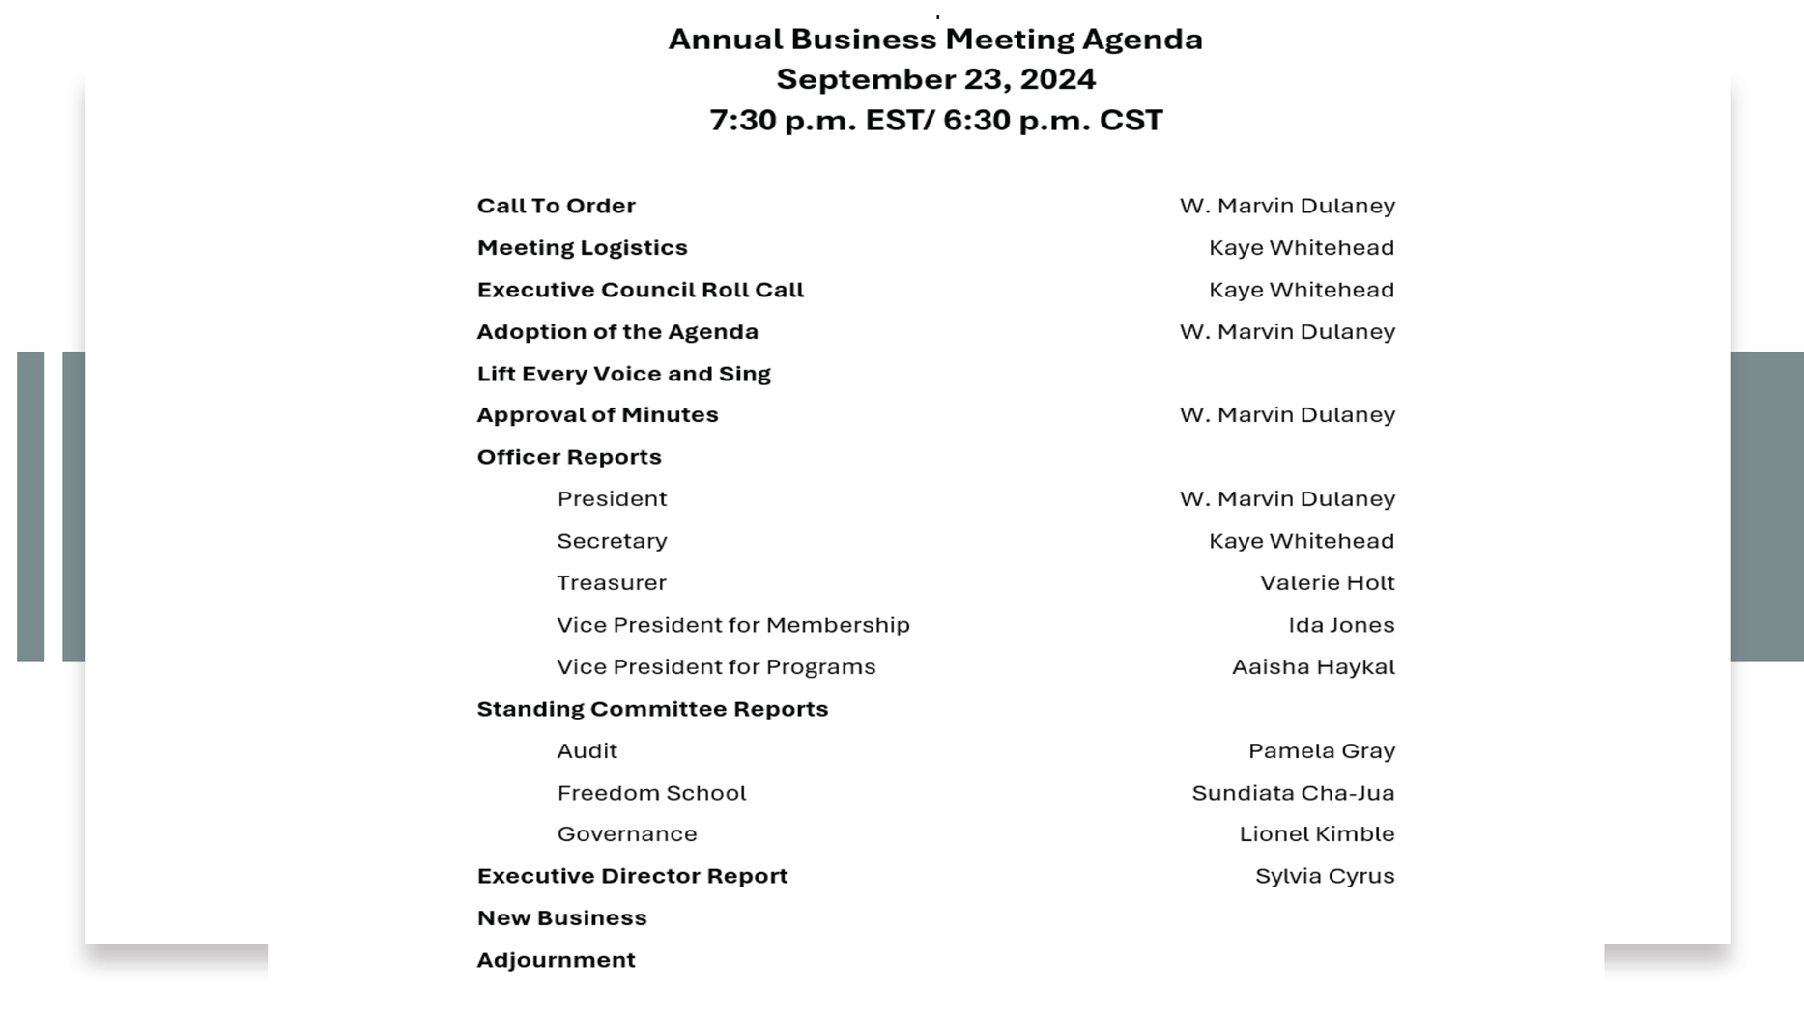
AGENDA

Slide 9
MOTION
MOTION TO ADOPT THE AGENDA OF THE 2024 ANNUAL BUSINESS MEETING

Slide 10

LIFT EVERY VOICE AND SING
"THE BLACK NATIONAL ANTHEM," LIFT EVERY VOICE AND SING WAS A HYMN WRITTEN AS A POEM BY NAACP LEADER JAMES WELDON JOHNSON IN 1900.

Slide 11
MINUTES OF 2023 Annual Business Meeting
W. MARVIN DULANEY, PRESIDENT OF ASALH

Slide 12
MOTION
MOTION TO APPROVE THE 2023 ANNUAL BUSINESS MEETING MINUTES (9/18/2023)

Slide 13
MINUTES OF 2023 Special Business Meeting
W. MARVIN DULANEY, PRESIDENT OF ASALH

Slide 14
MOTION
MOTION TO APPROVE MINUTES OF 2023 SPECIAL BUSINESS MEETING (10/30/2023)

Slide 15
REPORT OF OFFICERS
PRESIDENT, TREASURER, VICE PRESIDENT FOR PROGRAMS

Slide 16
REPORT OF THE PRESIDENT
W. MARVIN DULANEY, PRESIDENT OF ASALH

Slide 17
THANK YOU!
  Local Arrangements Committee
  United States Postal Service
  Executive Council
  Academic Program Committee
  Pittsburgh Members
  Dr. Edna McKenzie Branch Members
  ASALH Staff
  Sponsors
  ASALH Members

Slide 18
BLACK HISTORY THEMES
2025 - AFRICAN AMERICANS AND LABOR
110th Anniversary of ASALH
2026 – A Century of Black History Commemorations
100th Anniversary of Negro History Week
50th Anniversary of Black History Month
250th Anniversary of the United States of America

Slide 19















2024 CONFERENCE SPONSORS
PLATINUM SPONSOR
DIAMOND SPONSOR
GOLD SPONSOR
CRYSTAL SPONSOR
EMERALD SPONSOR
RUBY SPONSOR
SAPHIRE SPONSOR
ADDITIONAL SPONSOR
MARVIN DULANEY BRANCH
THE COMMONWEALTH INSTITUTE FOR BLACK STUDIES AFRICAN AMERICAN AND AFRICANA STUDIES, COLLEGE OF ARTS AND SCIENCES UNIVERSITY OF KENTUCKY
MARGARET SEIDLER
Afro American Music Institute
GEORGE & HAZEL GILLIS

Slide 20
REPORT OF THE TREASURER
VALERIE HOLT, TREASURER OF ASALH

Slide 21
REPORT OF THE VICE PRESIDENT FOR PROGRAMS
AAISHA HAYKAL, VP FOR PROGRAMS OF ASALH

Slide 22
REPORT OF COMMITTEES
AUDIT, FREEDOM SCHOOLS, GOVERNANCE

Slide 23
AUDIT REPORT
PAMELA GRAY, ACCOUNTING CONSULTANT

Slide 24
AUDIT & FINANCE REPORT
ANITA SHEPHERD, CHAIRMAN

Slide 25

AUDIT & FINANCE
2024 COMMITTEE REPORT
Sept. 23, 2024
Committee Members:
Anita Shepherd, Chair
Jeff Banks
John Adams
Sylvia Cyrus
Marvin Dulaney
Aaisha Haykal
Valerie Holt

Slide 26

RESPONSIBILITIES OF THE COMMITTEE
The Audit & Finance Committee is a standing committee authorized by the ASALH Bylaws. It has oversight responsibilities for:
    Budget, Financial Planning, and Financial Management;
    Financial Statement Review and Audit;
    Financial Management, Risk Management, and the Internal Control System.
    The members and chair are appointed by ASALH’s President and shall consist of not less than five (5) members. The Treasurer shall serve as a member (not the Chair) of the Committee.

Slide 27

RESPONSIBILITIES OF THE COMMITTEE (CONTINUED)
Responsibilities of the Committee (continued)
The Audit and Finance Committee is responsible for ensuring that ASALH operates in an ethical environment and complies with laws and regulations. The Committee shall be sufficiently transparent in its activities to support sharing relevant information with the Executive Council and must also:
  Establish effective communication, both internally among committee members and externally with management, auditors and all members of the Executive Council.
  Ensure diversity among committee members in terms of experience and knowledge to enhance its capabilities and proficiency.

Slide 28
2024 ACCOMPLISHMENTS
  Ensured oversight of expenditures of ASALH’s operational budget
  Scheduled A& F Committee meetings to review the monthly statements received from ASALH’s accountant from Jan. to July 31, 2024.
  Presented timely financial reports by ASALH’s Treasurer to the Executive Council. for acceptance.
  Received the Auditor’s Reports from Pam Gray of SB & Company, LLC (SBC). There were no adverse findings with ASALH’s financial management, internal controls, and compliance.
  Received the Auditor’s Reports for ASALH’s compliance with Government Auditing Standards for contracts or grant agreements applicable to the Association’s Federal programs and financial statements for 2022 and 2023.
  Ensured required corporate filings with Washington DC - Certificate of Amendment of the ASALH Articles of Incorporation and "Afro-American" Articles of Incorporation of ASALH, and the amendment to those Articles of Incorporation that changes the name to "African American".
  Will receive tax relief with the filing of ASALH’s Articles of Incorporation with the state of Pennsylvania for the Annual Conference.

Slide 29
IN SUMMARY
• ASALH’S Audit and Finance Committee worked diligently to perform the oversight responsibilities by the organization’s governing documents.
• The audits by SB& Company, LLC had no adverse findings.
•ASALH would benefit from having maximum enrollment in the Annual Conference, increases in sponsorships and contributions, and a successful year-end campaign to meet the budget.
• The challenge is to continue to control expenses and increase revenue. The committee appreciates the support of the ASALH staff, all committees, and individuals as we continue to “move forward” as the premier organization of Dr. Carter G. Woodson.
• Special thanks for the leadership of President Marvin Dulaney and support of Executive Director Sylvia Cyrus.

Slide 30
ACTION ITEMS
MOTION: THE A&F COMMITTEE MOVES THE ACCEPTANCE OF THE AUDITOR’S REPORTS PRESENTED BY PAM GRAY OF SB & COMPANY, LLC (SBC).

Slide 31
MOTION
MOTION TO ACCEPT OF THE AUDITOR’S REPORT PRESENTED BY PAM GRAY OF
SB & Company, LLC (SBC).

Slide 32
FREEDOM SCHOOLS REPORT
SUNDIATA CHA-JUA, CHAIRMAN

Slide 33
GOVERNANCE REPORT
LIONEL KIMBLE, CHAIRMAN

Slide 34
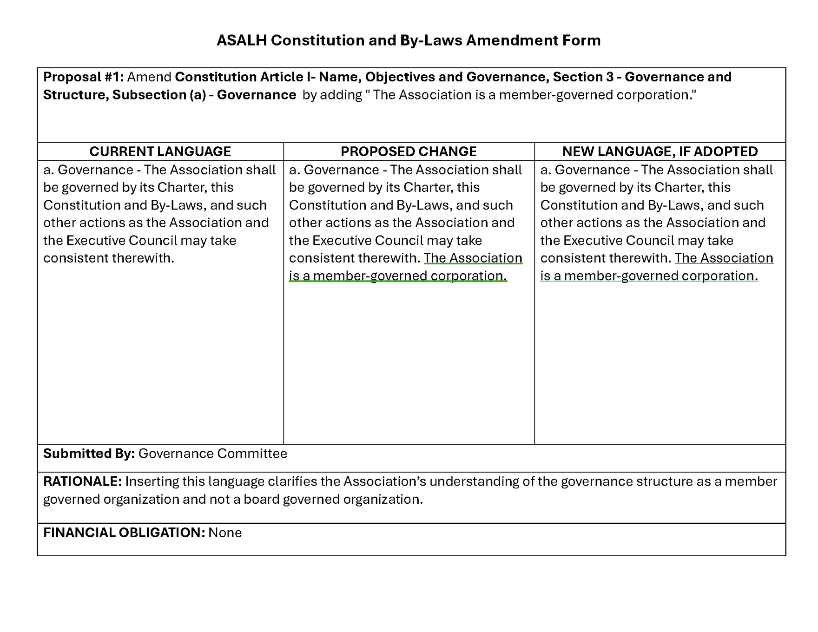
PROPOSAL #1

Slide 35
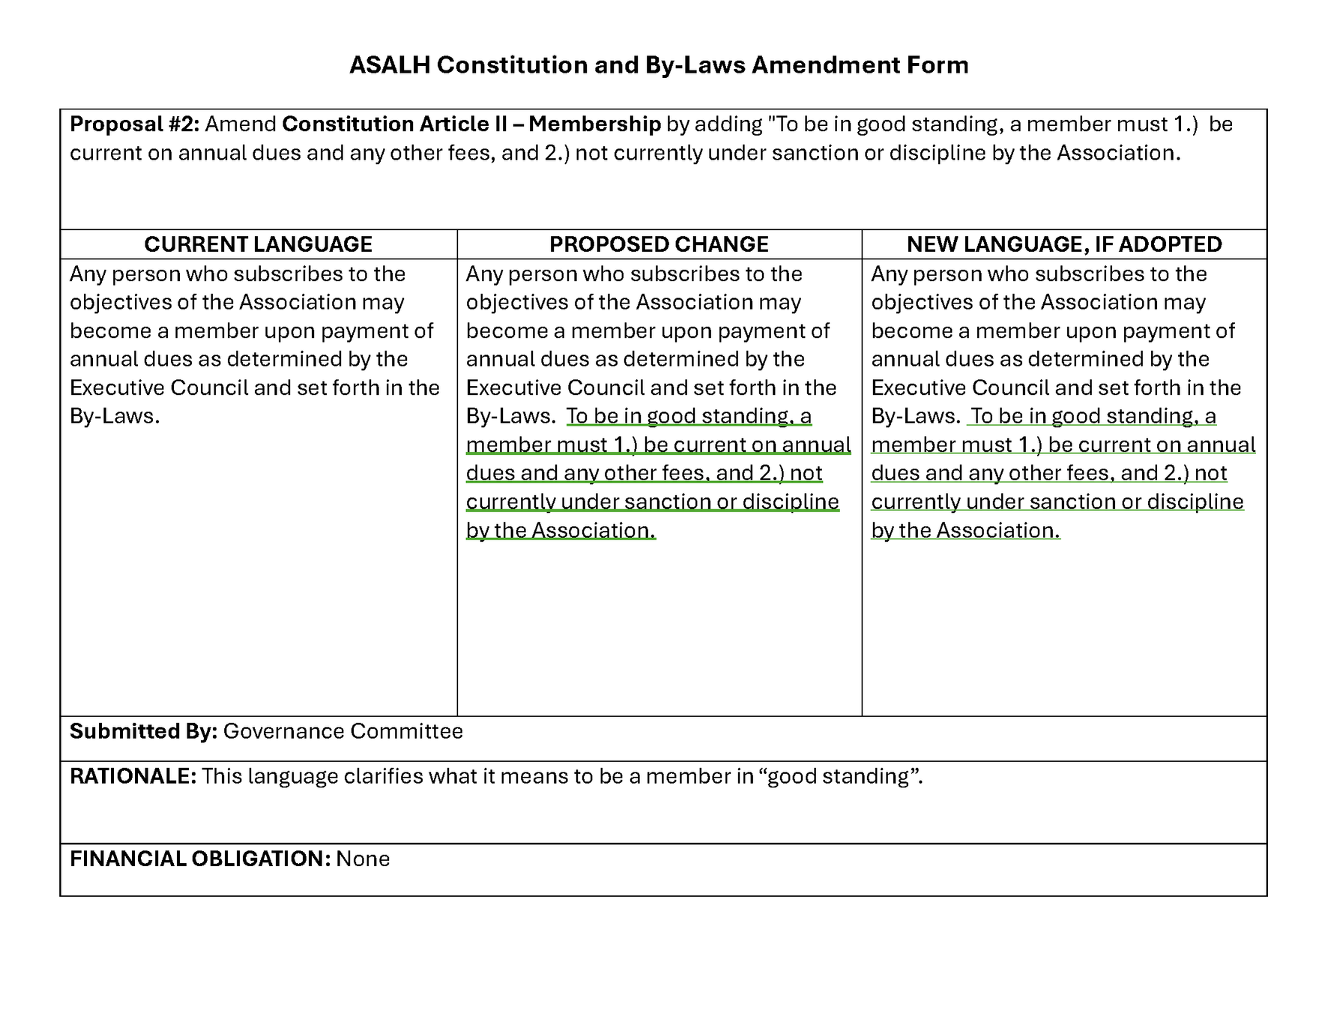
PROPOSAL #2

Slide 36
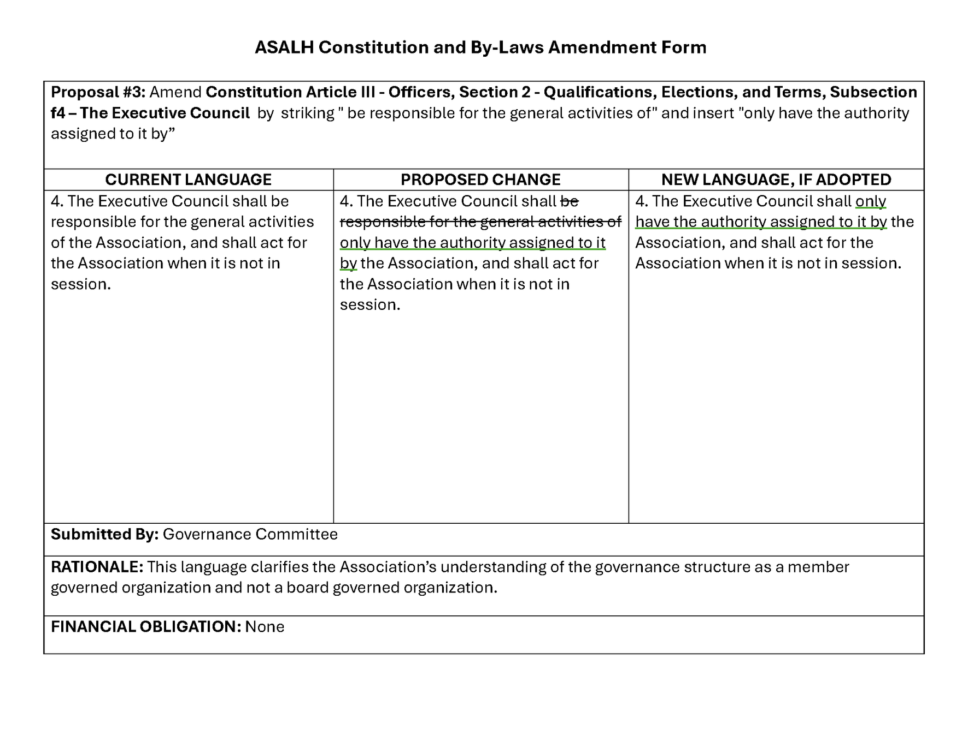
PROPOSAL #3

Slide 37
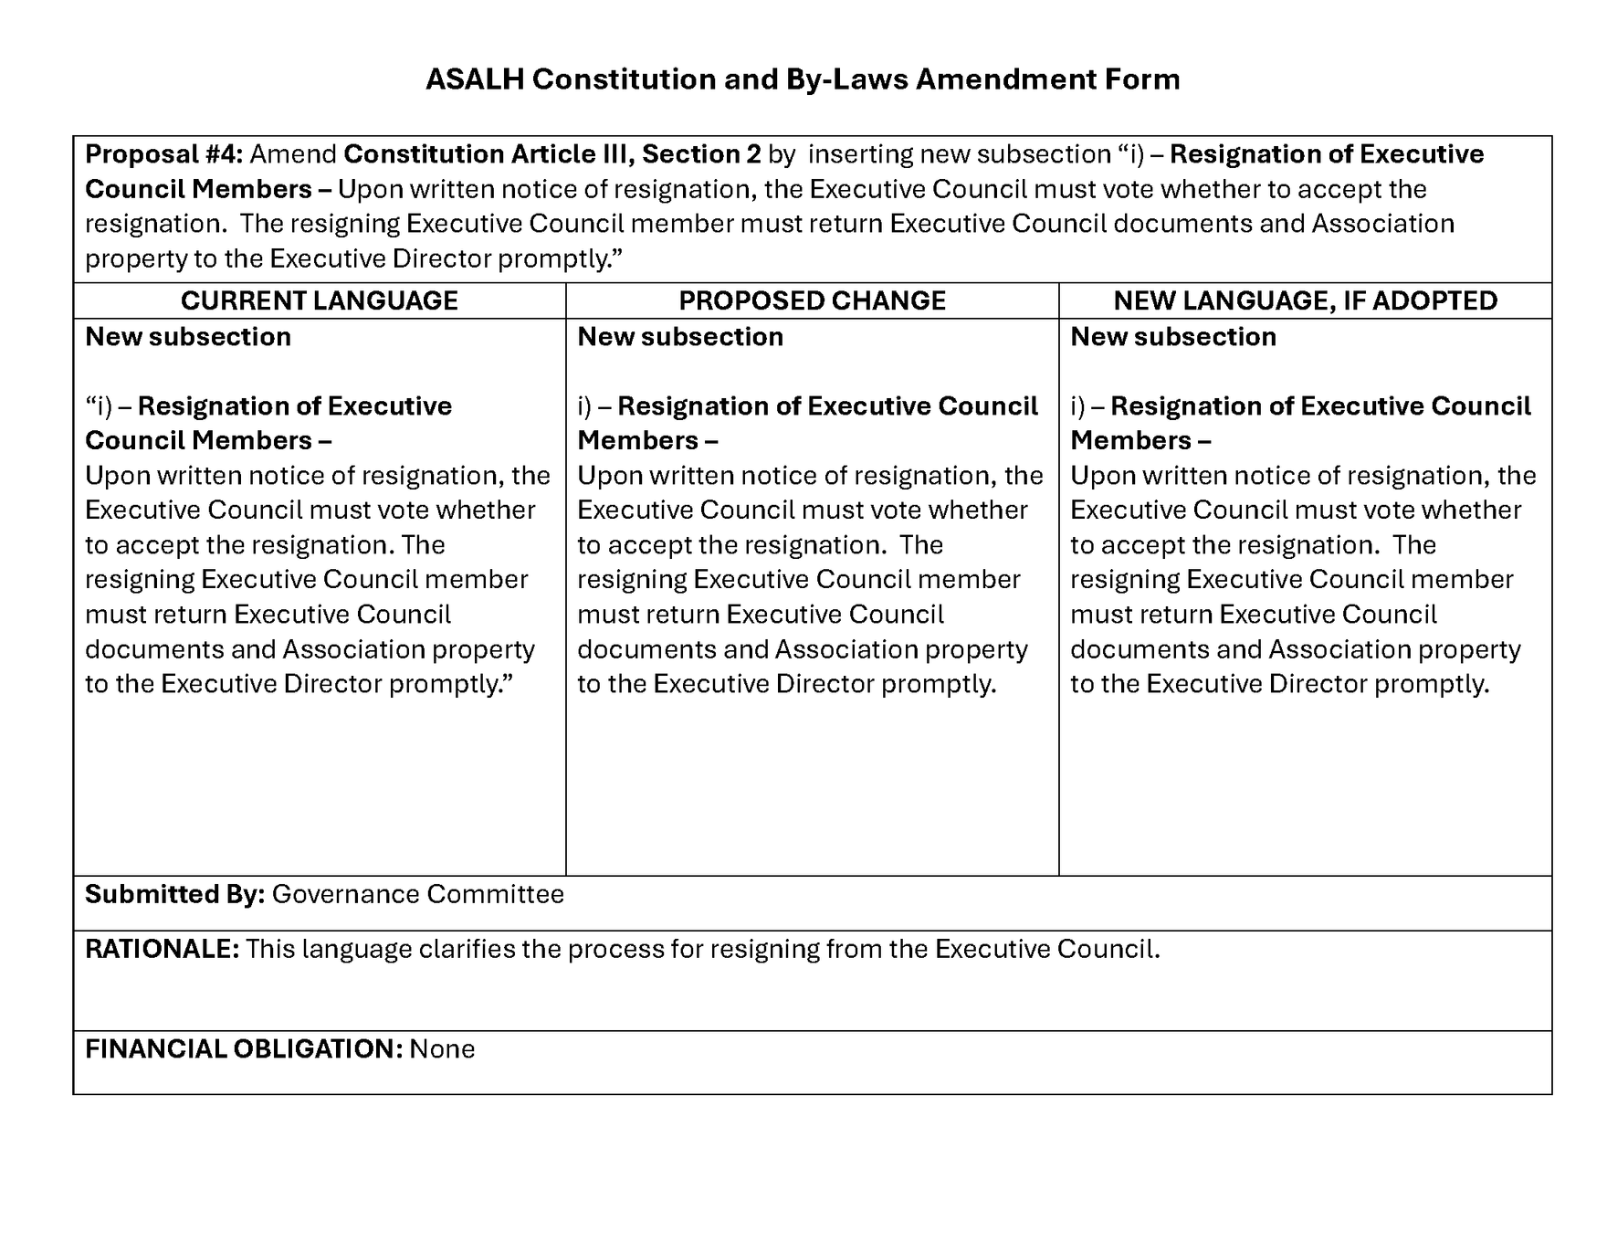
PROPOSAL #4

Slide 38
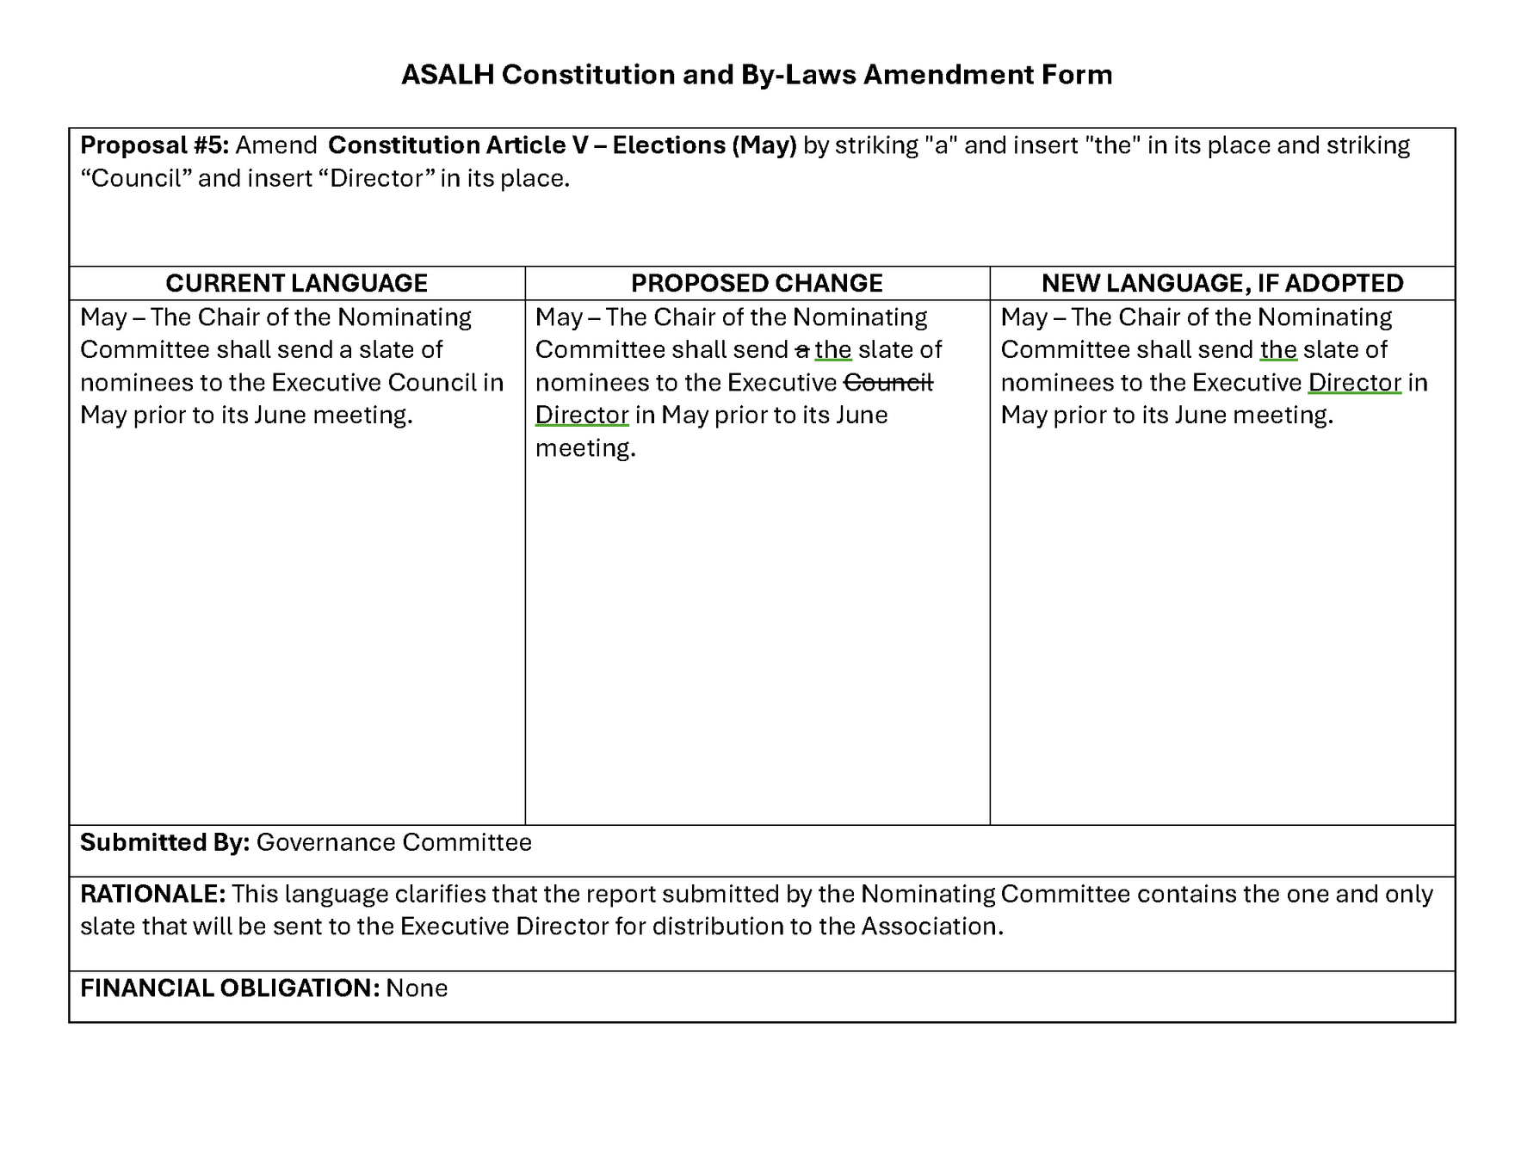
PROPOSAL #5

Slide 39
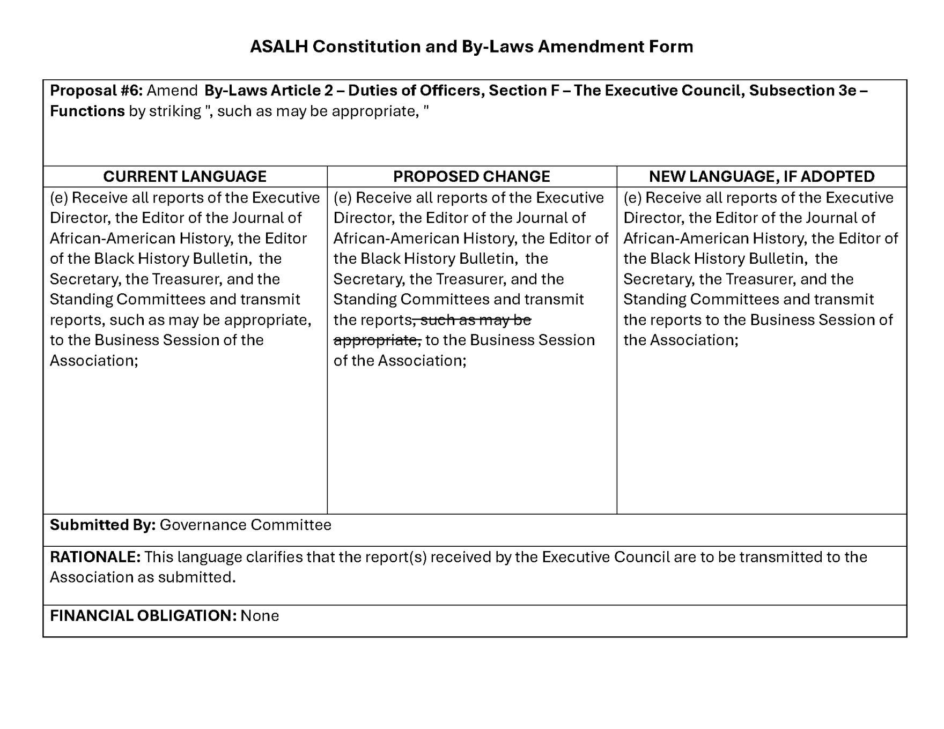
PROPOSAL #6

Slide 40
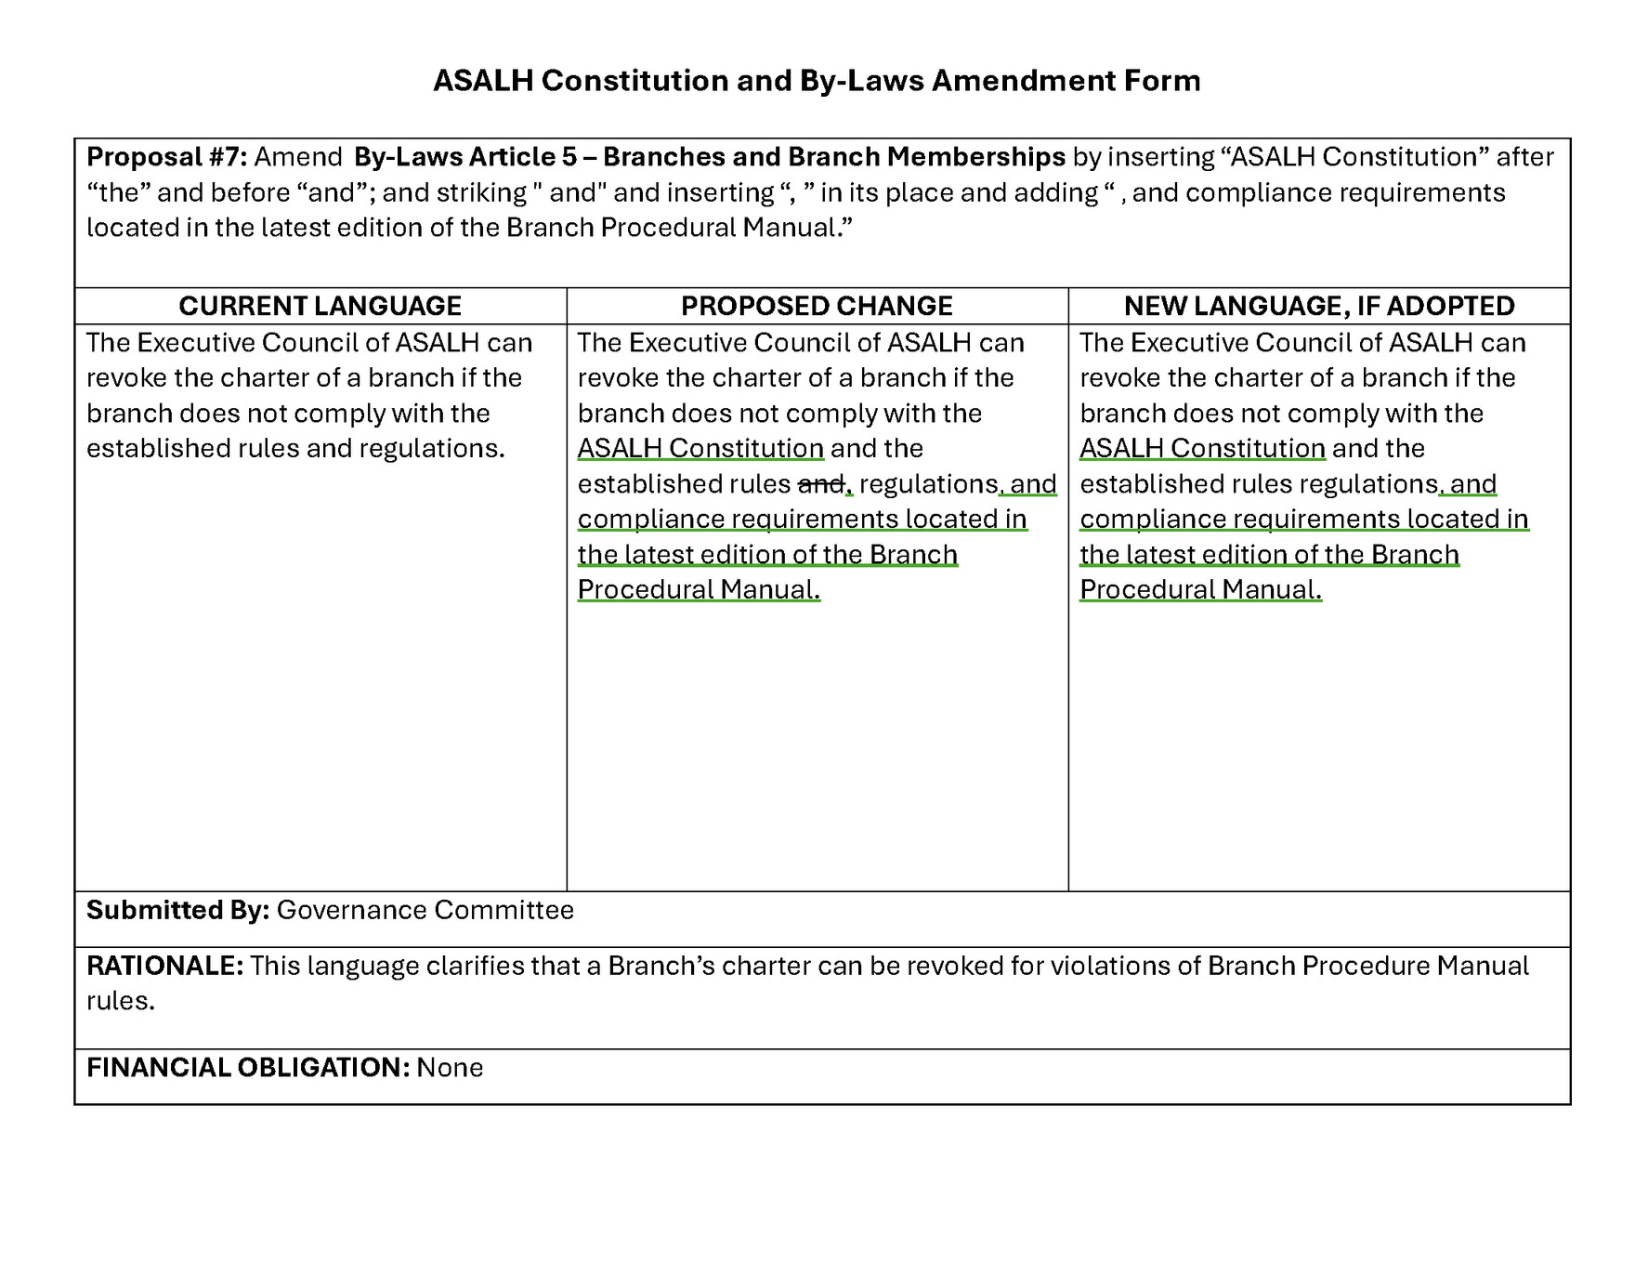
PROPOSAL #7

Slide 41
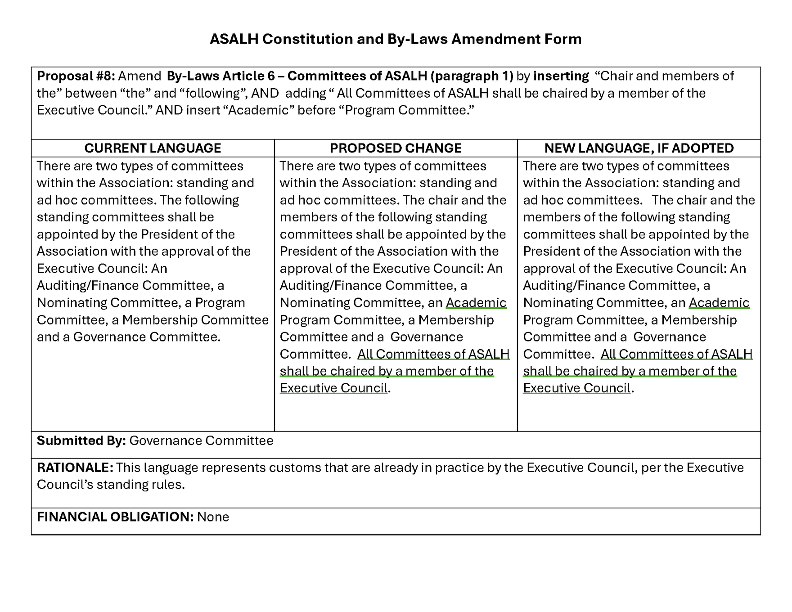
PROPOSAL #8

Slide 42
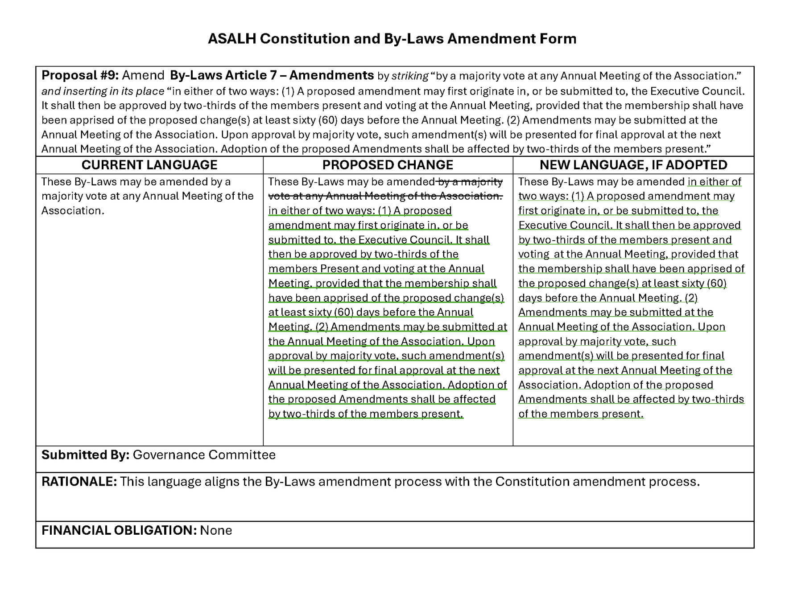
PROPOSAL #9

Slide 43
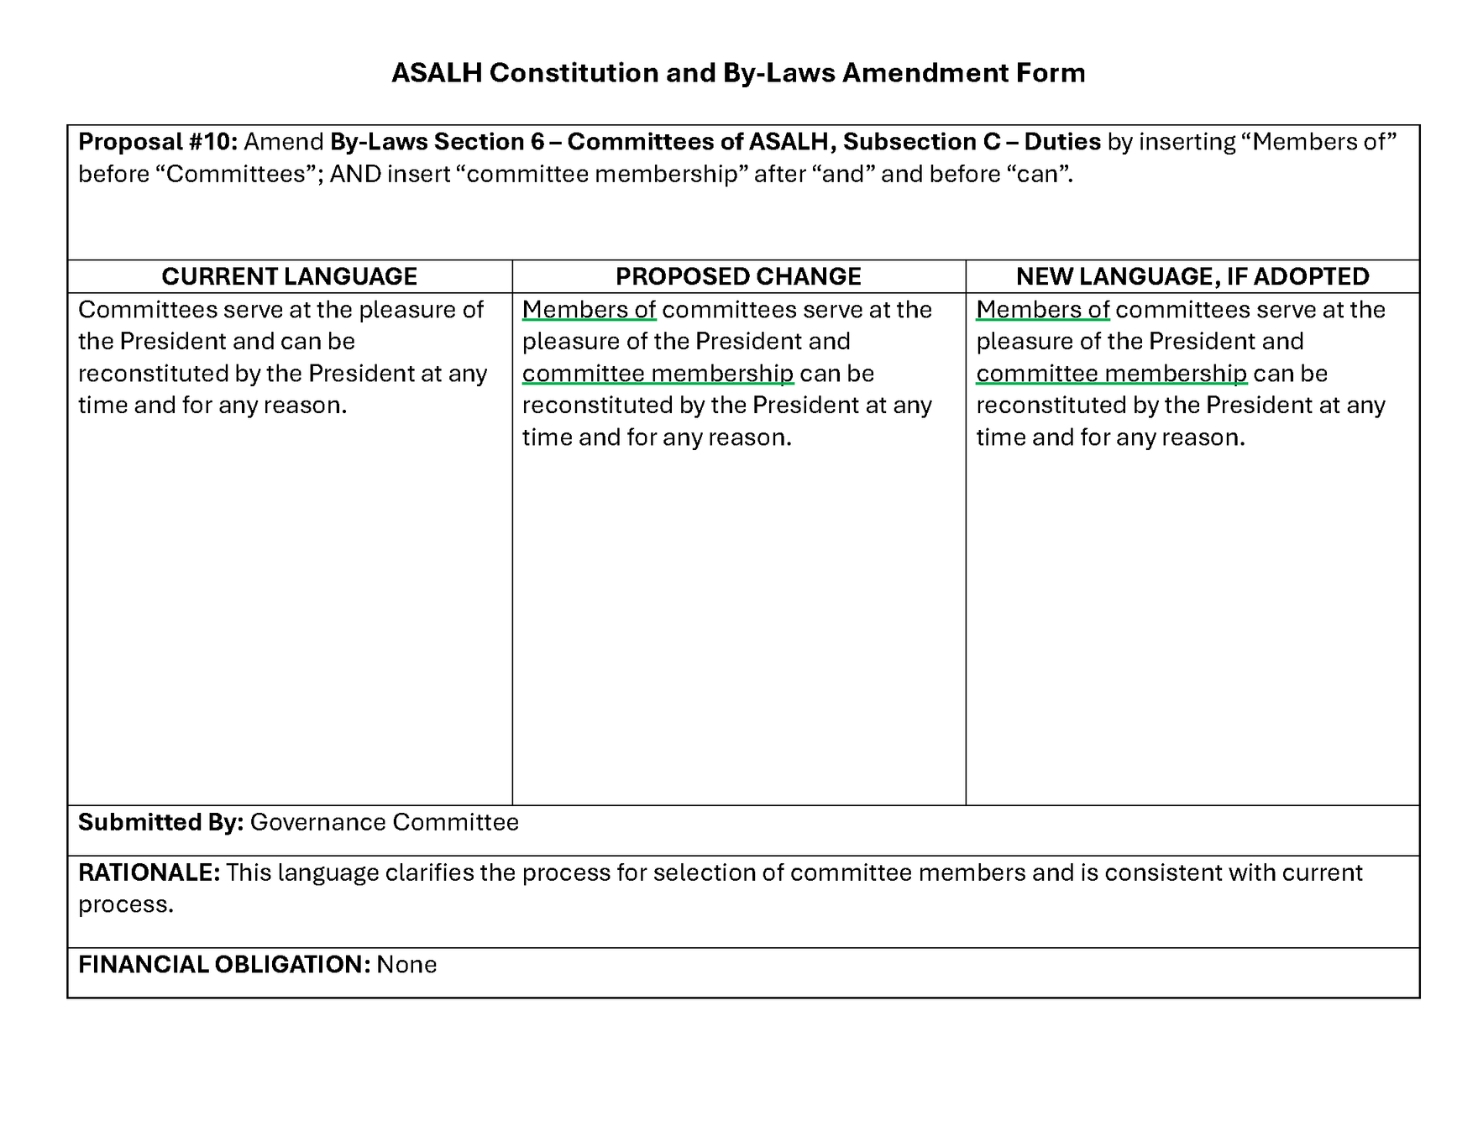
PROPOSAL #10

Slide 44
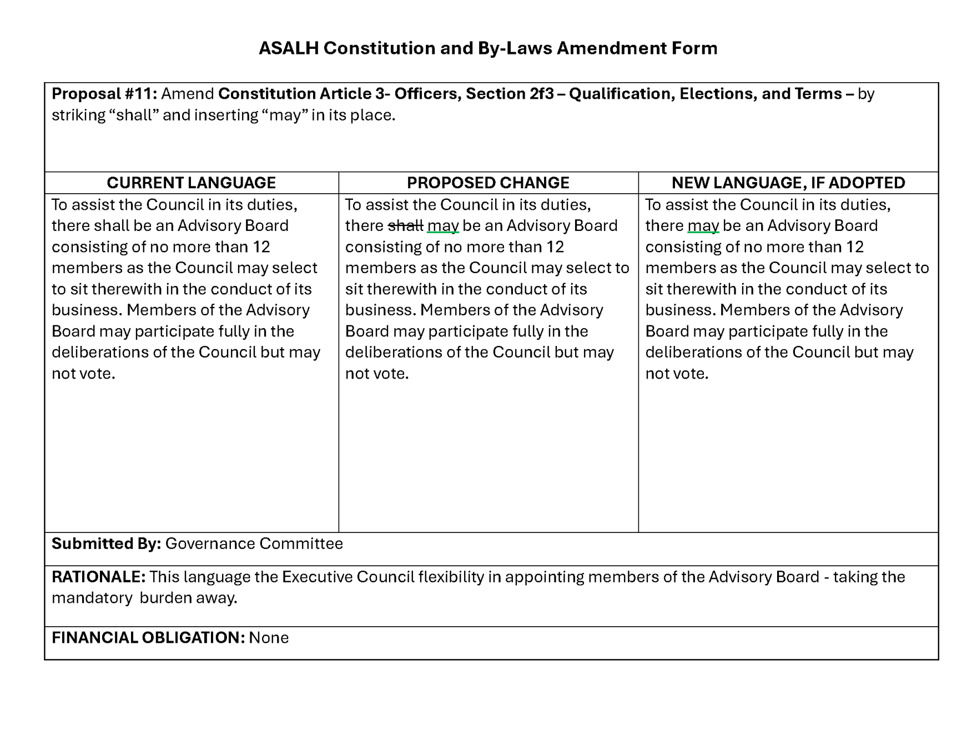
PROPOSAL #11

Slide 45
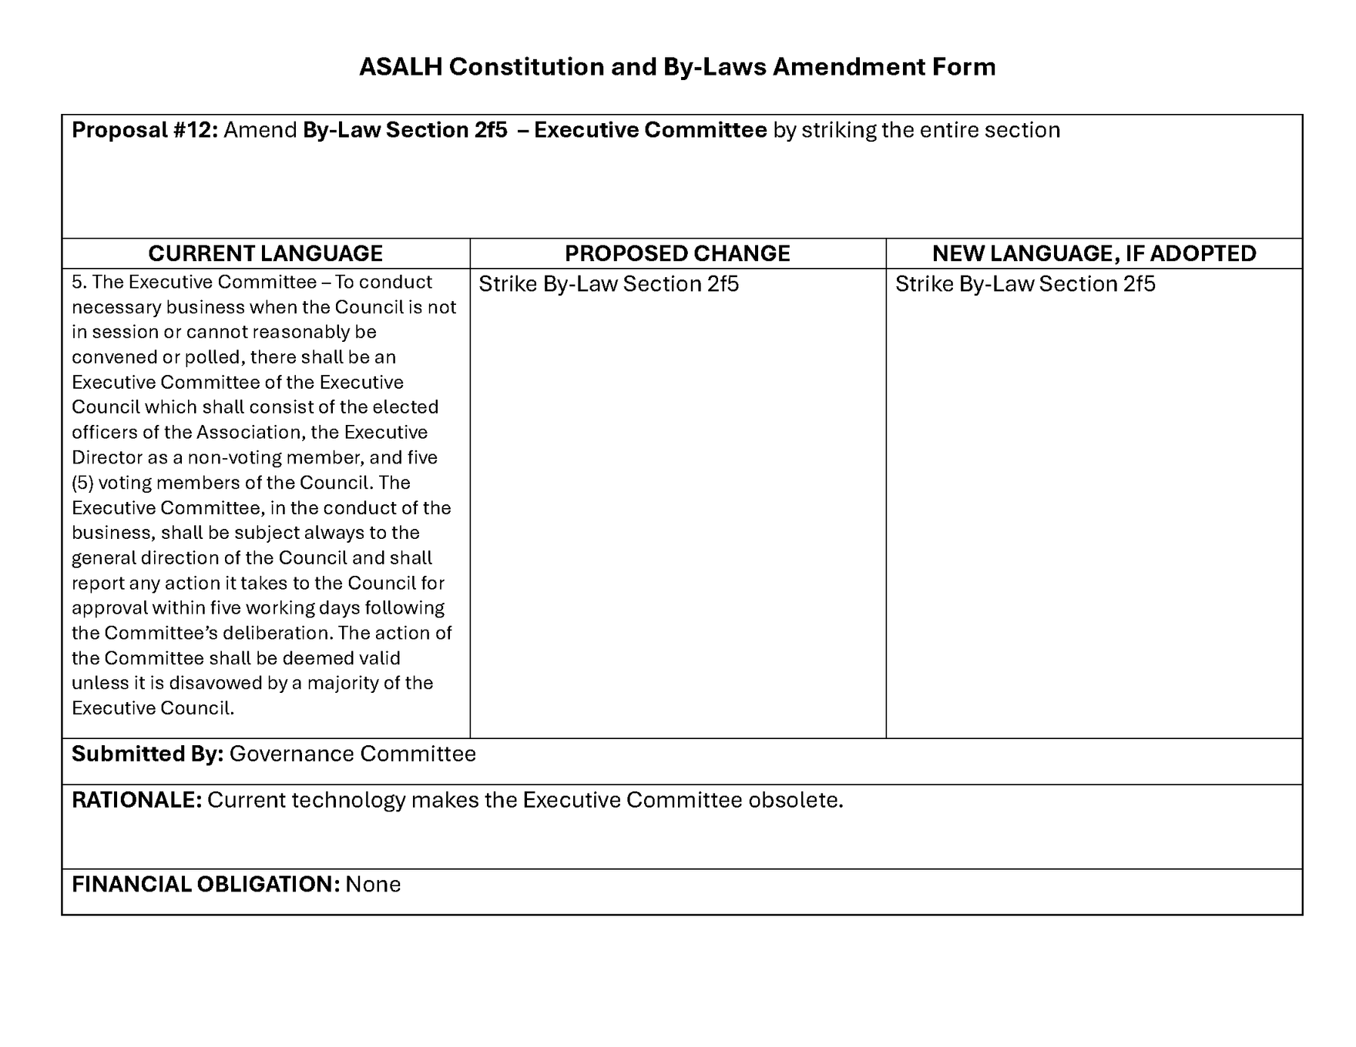
PROPOSAL #12

Slide 46
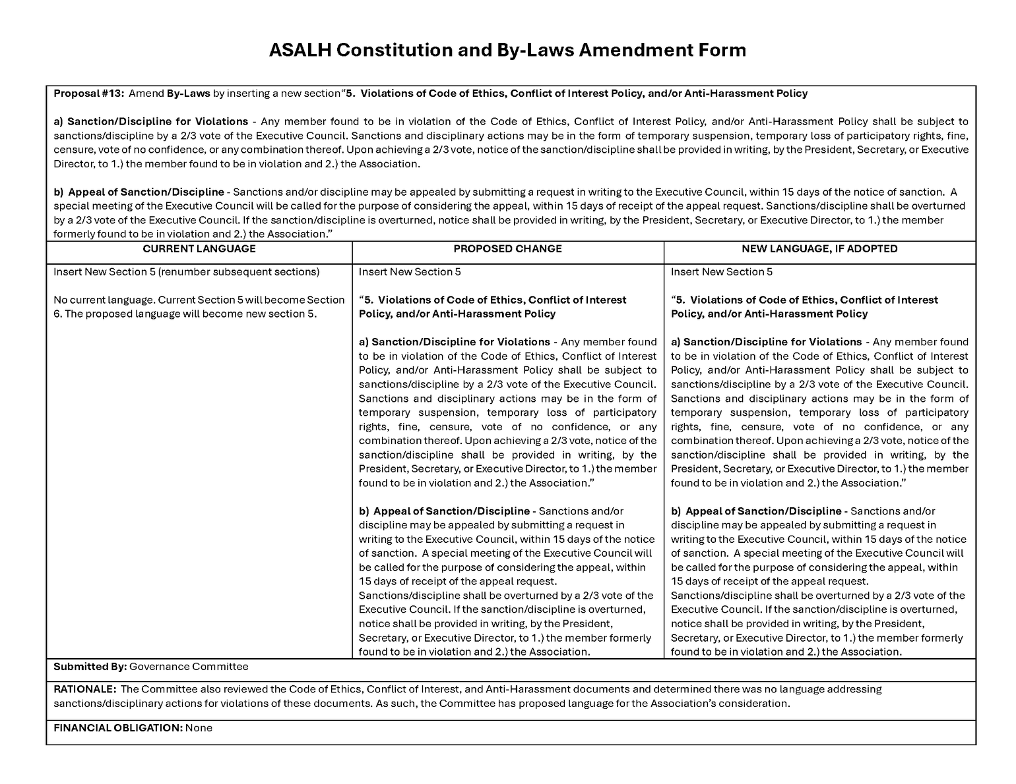
PROPOSAL #13

Slide 47
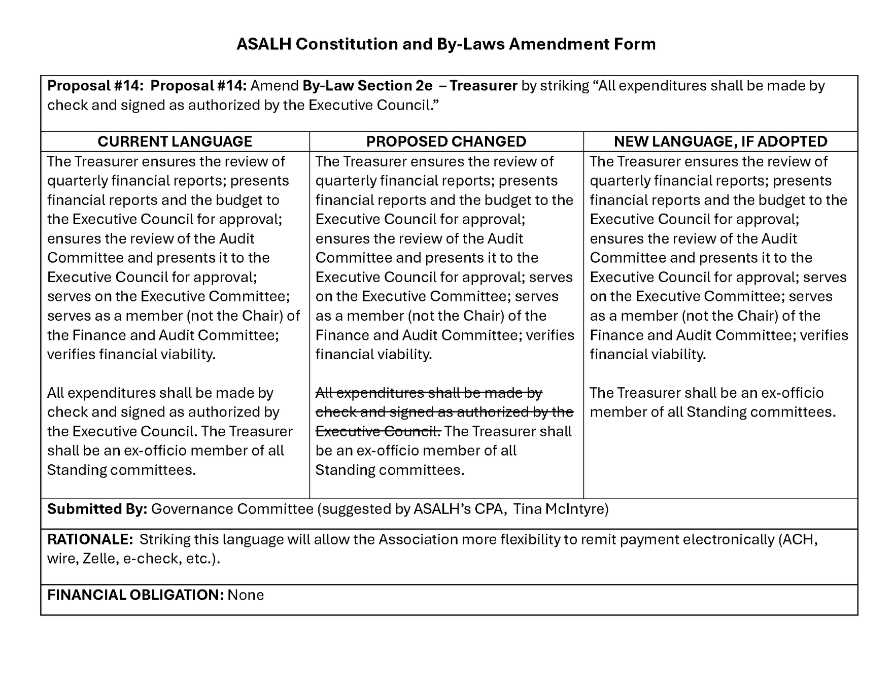
PROPOSAL #14

Slide 48
REPORT OF THE
Executive Director
SYLVIA CYRUS, EXECUTIVE DIRECTOR OF ASALH

Slide 49
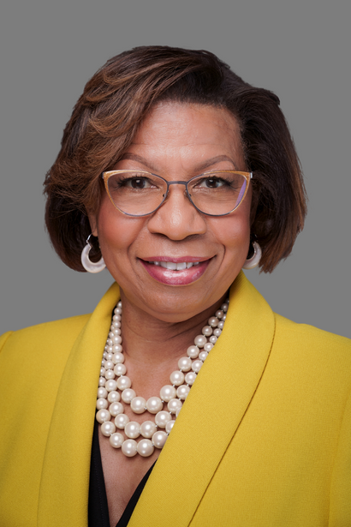
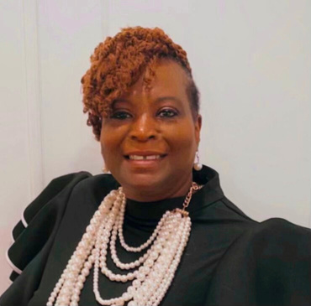
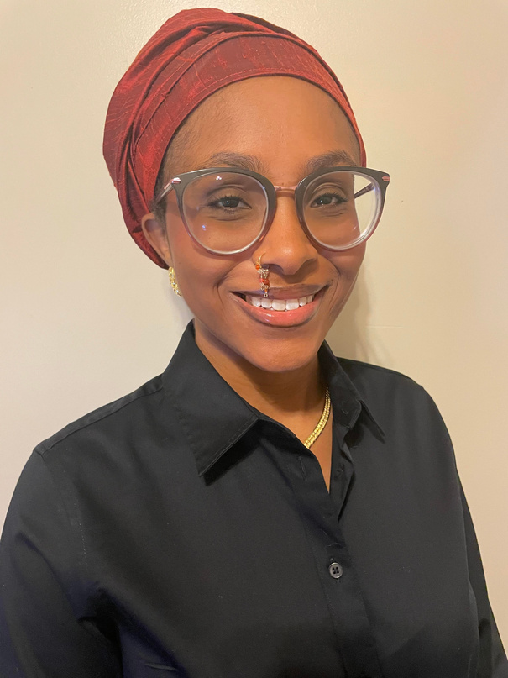
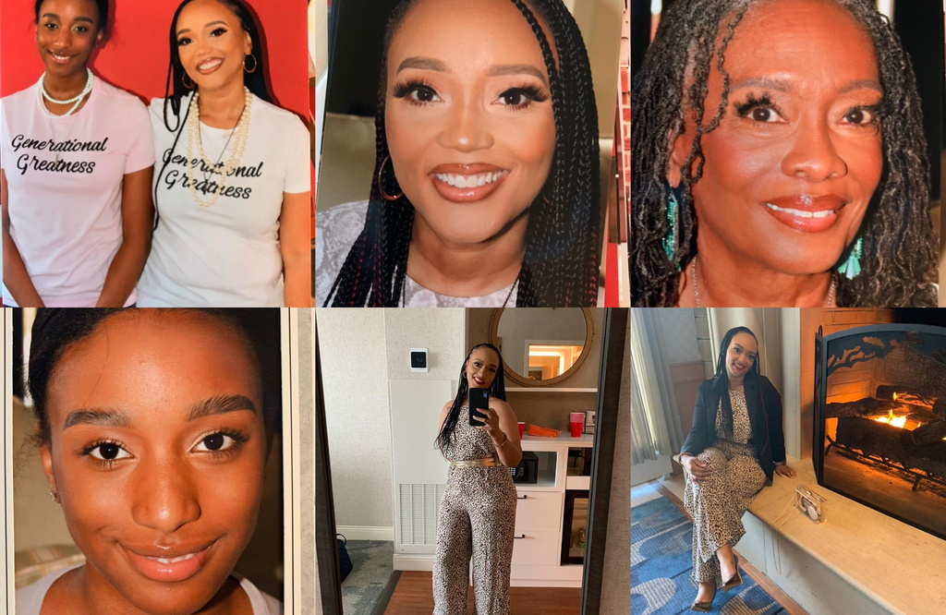
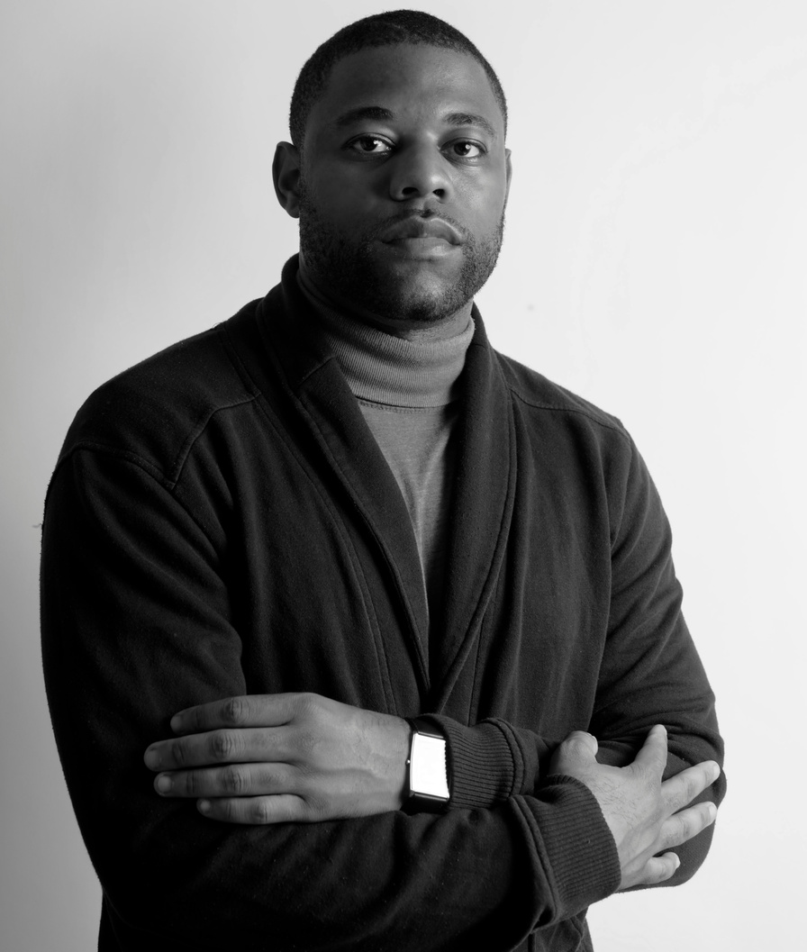
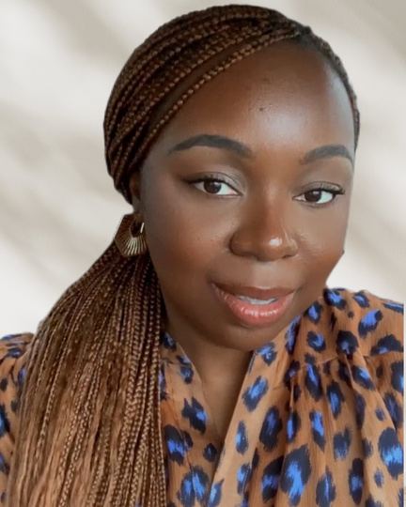
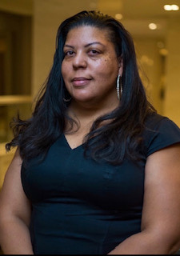
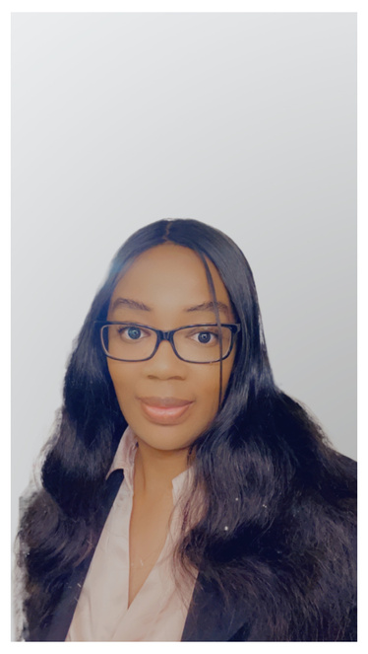
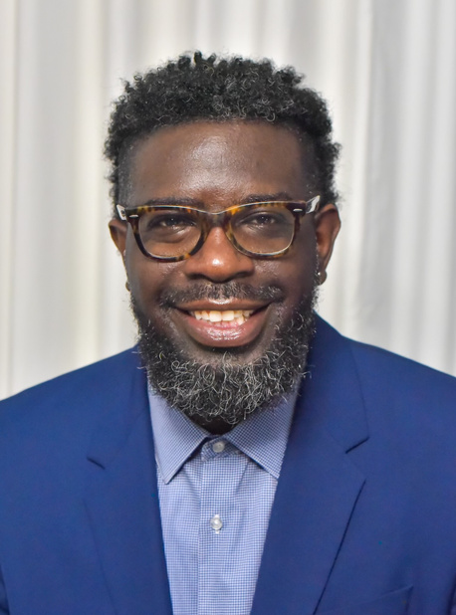
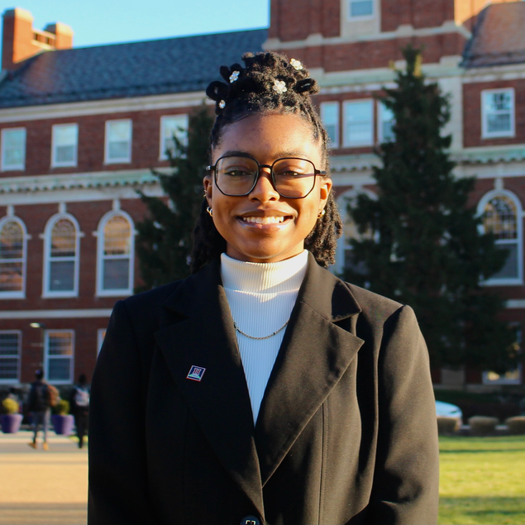
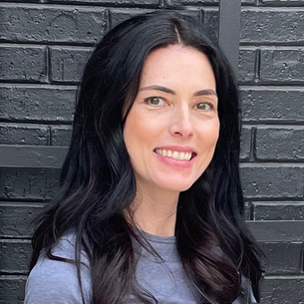
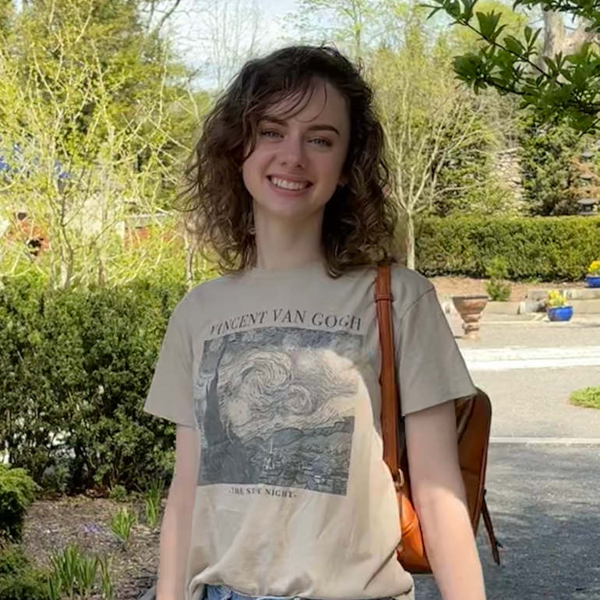
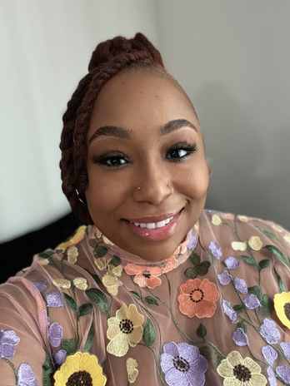
ASALH STAFF
THANKS TO ALL THE STAFF FOR THEIR HARD WORK HELPING MAKE THE CONFERENCE A SUCCESS
SYLVIA Y. CYRUS
EXECUTIVE DIRECTOR
WANDA FLOWERS
OPERATIONS MANAGER
TAYLOR GRESHAM
ASALH Support Staff
KAY PHILLIPS
PROGRAMS MANAGER
ROBERT BRODIE
EXECUTIVE ASSISTANT
GLORIA NKANKA
MEMBERSHIP SUPPORT
CRYSTAL BOSWELL
SPECIAL PROJECTS
ARIEL ROY
AACRN PARTNER HISTORIAN,
PARK HISTORY PROGRAM
DANIEL BROYLD
NETWORK TO FREEDOM
CHENELLE CATES
SOCIAL MEDIA MANAGER
RORY GRULER
CREATIVE DIRECTOR
KIRSTEN HAAKONSEN
SENIOR DESIGNER
DELANI WEAVER
WEB CONTENT SPECIALIST

Slide 50
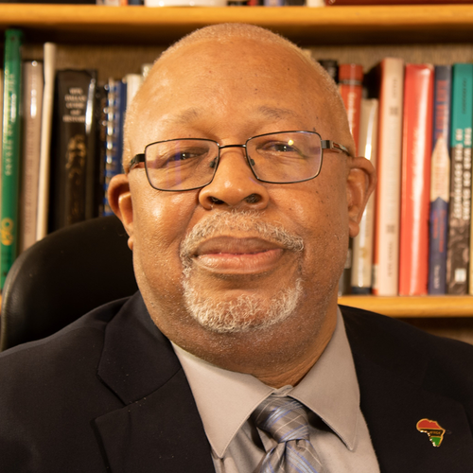
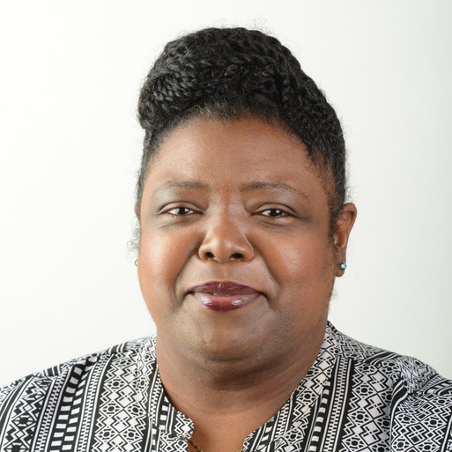
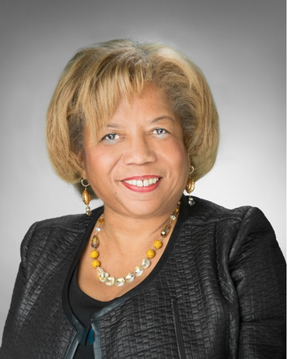
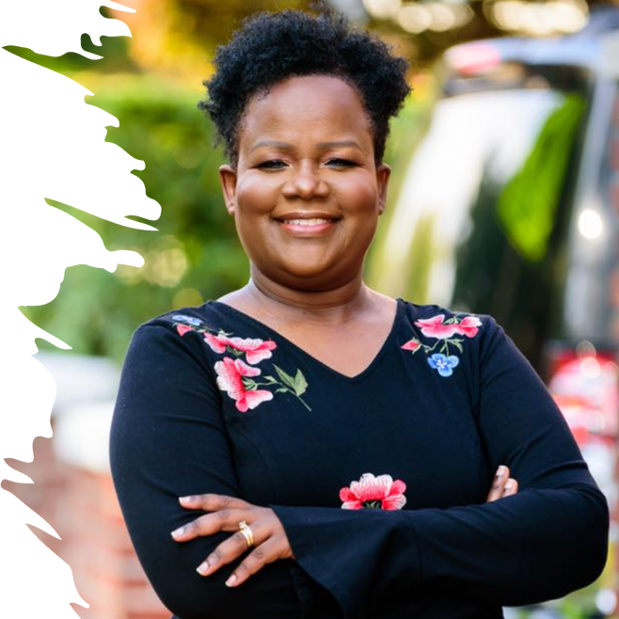
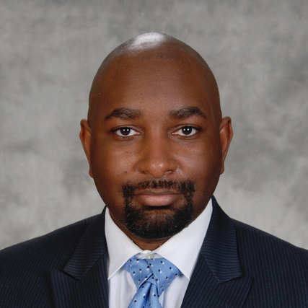
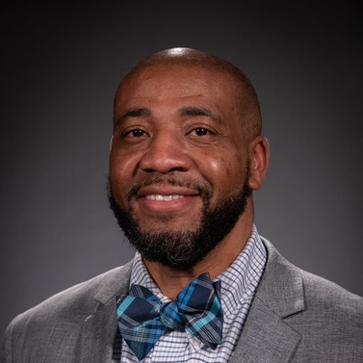
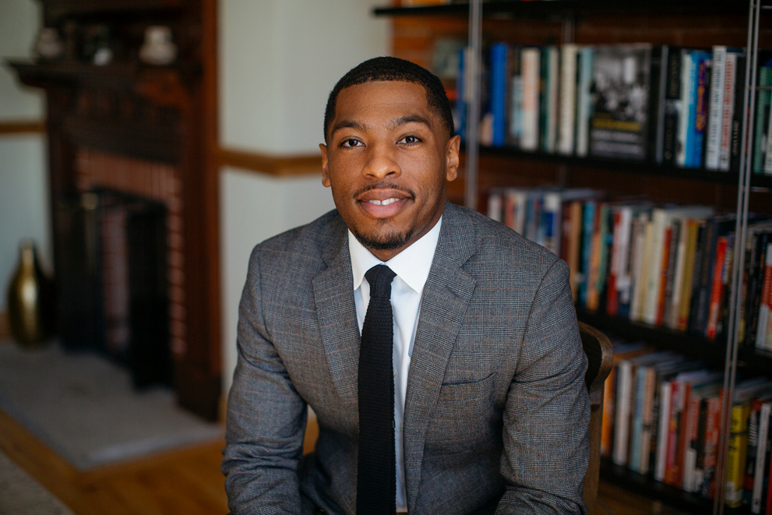
THANK YOU
TO THE OUTGOING MEMBERS OF THE EXECUTIVE COUNCIL
W. MARVIN DULANEY
Ida Jones
VALERIE HOLT
Norka Blackman-Richard
ALBERT THOMPSON
LESLIE ETIENNE
Jarvis Givens

Slide 51
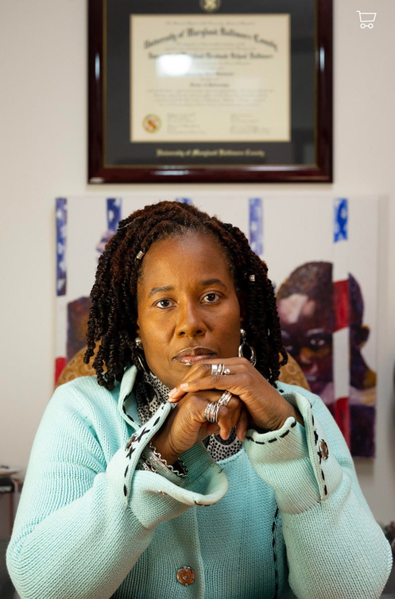
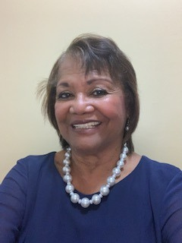
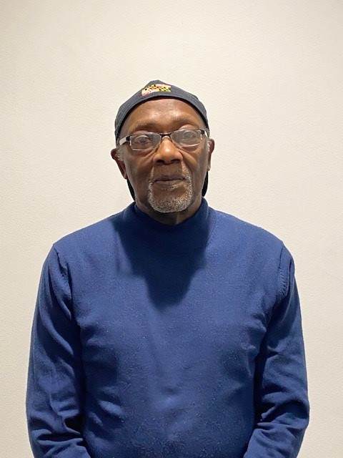
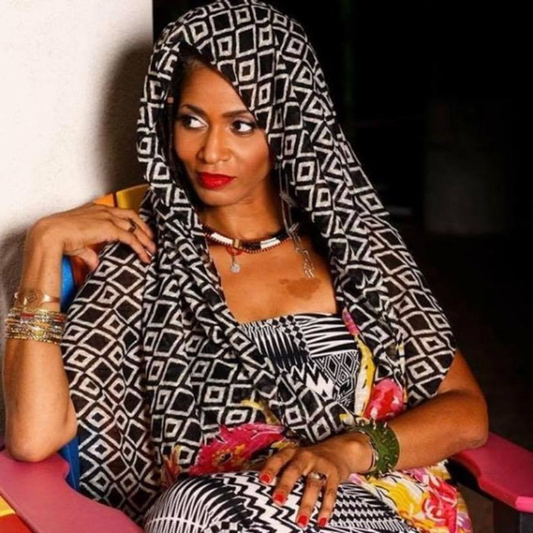
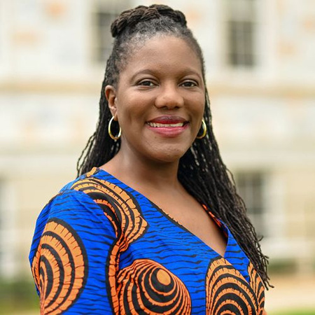
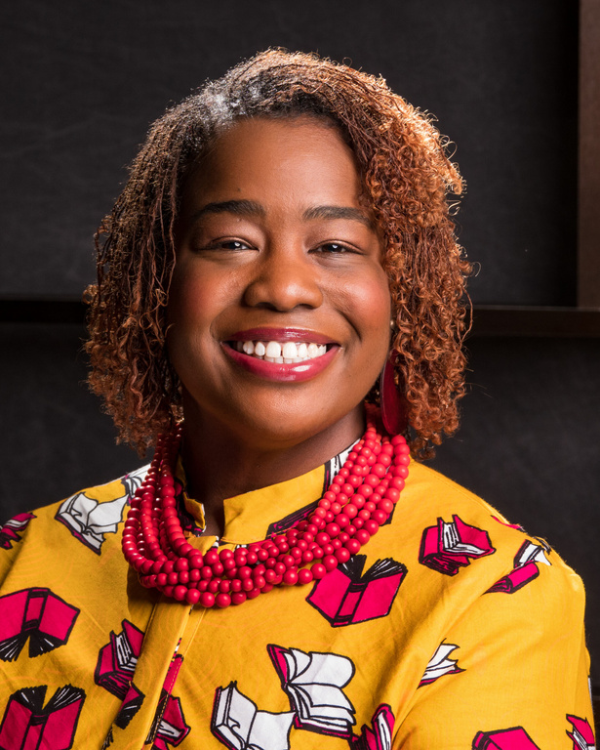
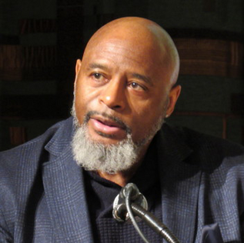
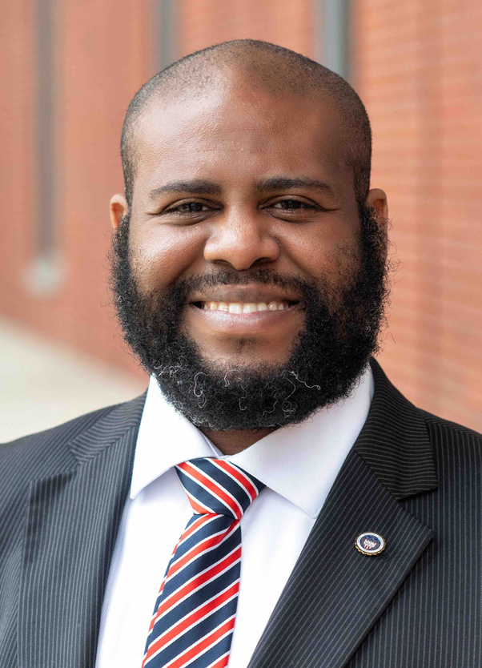
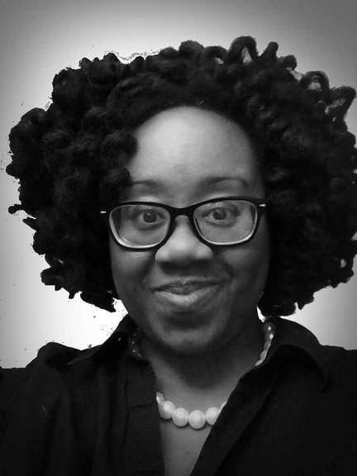
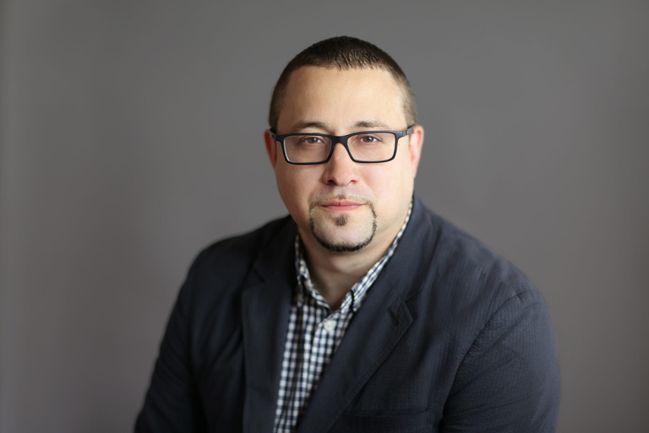
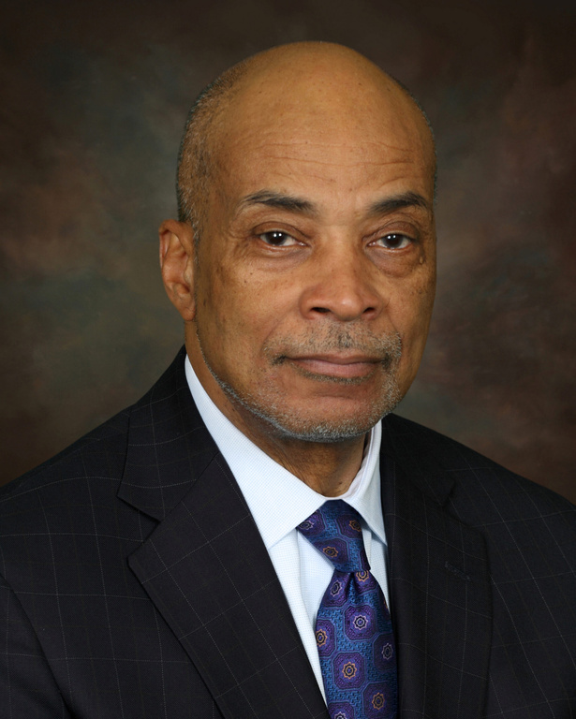
WELCOME
TO THE INCOMING MEMBERS OF THE EXECUTIVE COUNCIL
KARSONYA "KAYE” WISE
Whitehead, President
Anita Shepherd, Vice President
for Membership
JOHN ASHLEY, CORPORATE MEMBER
CHADRA PITTMAN, STUDENT
Crystal Sanders
Crystal Moten
Sundiata Cha-Jua
Lopez Matthews
Camesha Scruggs
Zebulon Miletsky
Carlton Wilson

Slide 52
NEW BUSINESS
W. MARVIN DULANEY, PRESIDENT OF ASALH

Slide 53
ADJOURNMENT
THE NEXT ASALH ANNUAL MEETING IS SEPTEMBER 24-28, 2025, AT THE Omni Atlanta Hotel at Centennial, in Atlanta, GA.

Slide 54
REMEMBRANCE OF OUR ASALH MEMBERS AND LOVED ONES
Burrell, Rev. Joan Hamilton Crawford
Ford, John L., Sr.
Guilford, Virginia B.
Haney-Galvin, Edith
Hardin, Philip Jason
Israel, Abinadab
Jirran, Raymond
Lee, Marie Dunlap
Lewis, Elnora E.
Lucas, Myrtle Marie
Madison, Joe
Ojoyo, Khamil L.
Rambo, Ruth
Rawling, Elizabeth Miller
Reagon, Bernice Johnson
Scurry, Nathaniel “Nat”
Stalling, Kenneth “Kokayi: Jr.
Strickland, William “Bill”
Tabor, Connie
Taylor, Frazine
Taylor, Mattie I.
Trower-Subira, George
Ware, Donald Russell
Washington, Emanual
Washington, Ruth Helen

